Slide 1
Social Media - Digital Citizenship

Slide 2
What are different types of social media?

Slide 3
What about truth or dare?

Slide 4
Can you say it to their face?

Slide 5
Should you give your password out?

Slide 6
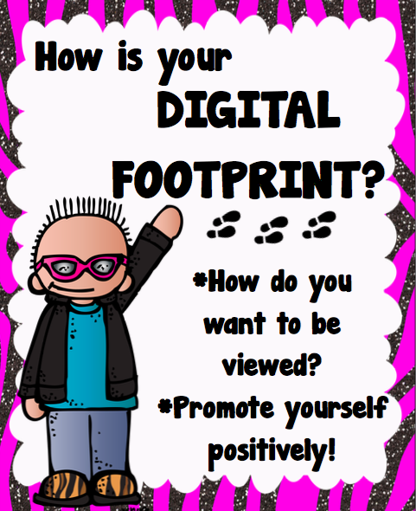

Slide 7
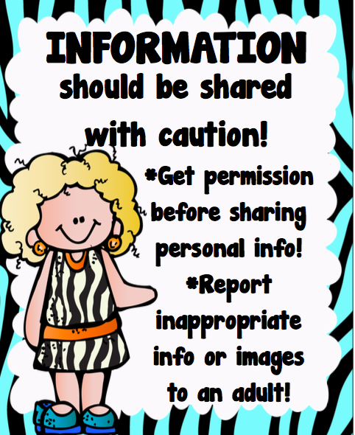

Slide 8
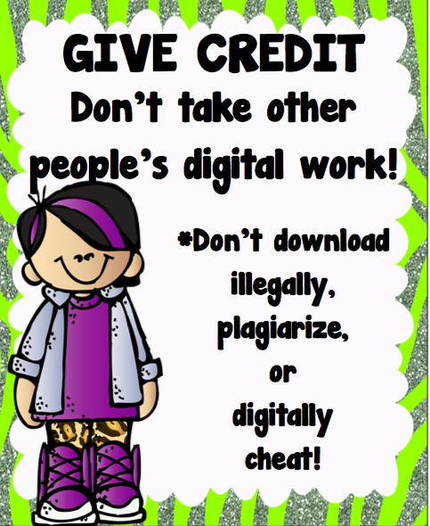

Slide 9
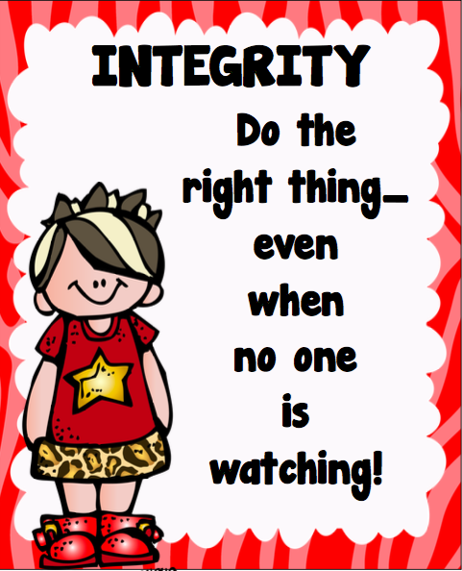

Slide 11
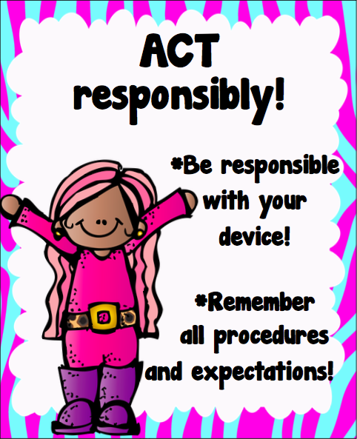

Slide 12
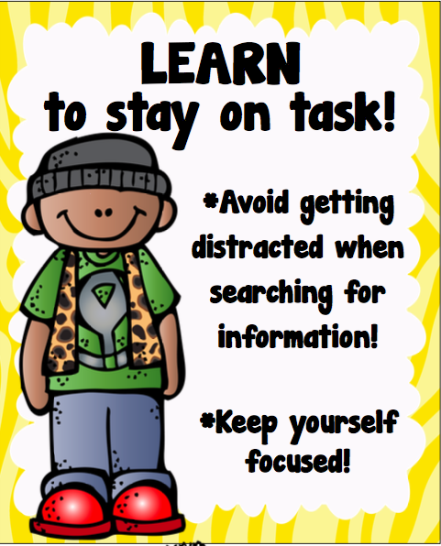

Slide 13
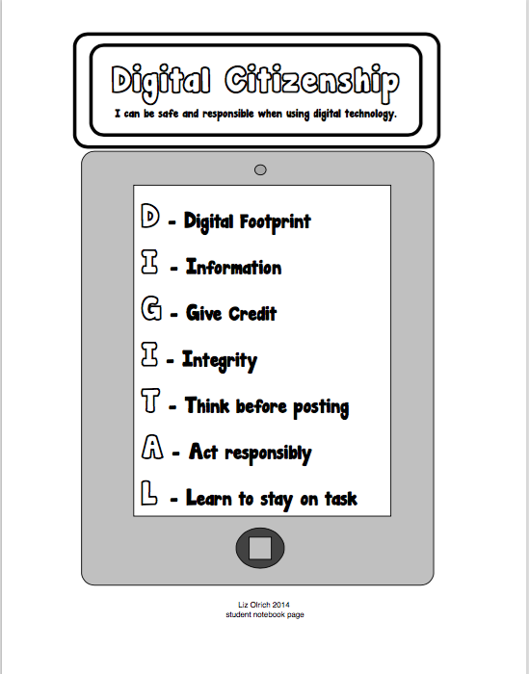

Slide 14
It’s permanent even though you set your profile as private, locked or even deleted. Someone could screenshot what you say.

