Slide 1
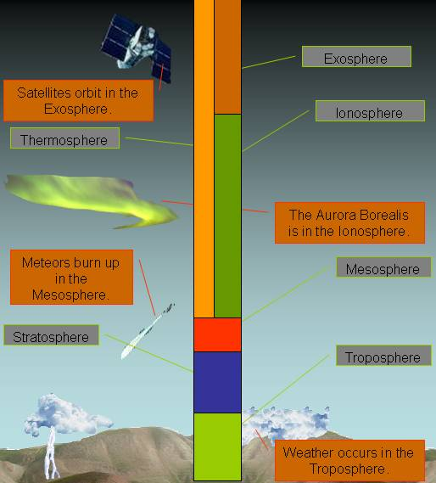
The Layers of the Atmosphere

Slide 2
Definitions
Atmosphere: mixture of gases that surrounds earth (or any planet or moon)
Altitude: height
Temperature: NOT HEAT; measurement of how hot or cold something is

Slide 3
Makeup of Gases in the Atmosphere
***Other gases *** 1%
Most of Earth’s atmosphere is not made up of oxygen. It’s mostly made of nitrogen. This is good because actually, with too much oxygen we would all die. Our insides would start to “rust!”
Oxygen
21%
*** the “other gases” include
argon, carbon dioxide, water
vapor and other gases. ***
Nitrogen 78%

Slide 4
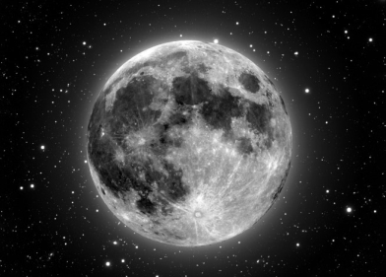
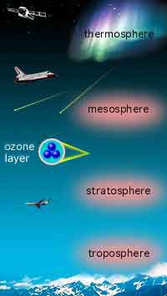
The Five Layers of the Atmosphere
EXOSPHERE
5
4
3
2
1

Slide 5
The Troposphere
Lies next to the Earth’s surface
Densest atmospheric level (because gravity pushes down on it the most)
Almost all gases, pollution and life found here
Layer where we live
Layer where weather occurs
Tropo means “turning” or “changing”. On this layer, gases turn and mix.

Slide 6
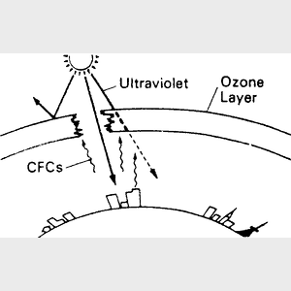
The Stratosphere
Air is very thin
There is almost no moisture in this layer so it’s very dry
Strato means “layer”. Gases here are “layered”.
They do not mix very much here.
* inside the stratosphere
* Contains ozone which absorbs sun rays and keeps us from overheating

Slide 7
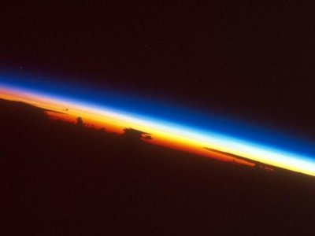
The Mesosphere Meso means middle.
Coldest layer
As altitude increases , temperature decreases
Very windy

Slide 8
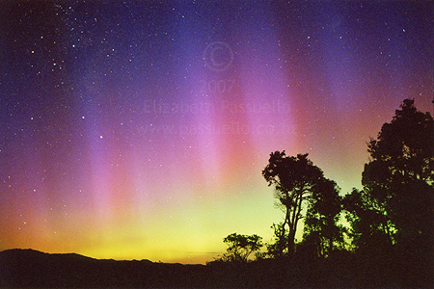
The Thermosphere
*Very high temperature (BUT IT IS NOT HOT).
*This is because the particles are moving fast but do not touch.
* Contains the ionosphere where electricity makes gases light up = The Northern and Southern Lights
Thermo means heat.

Slide 9
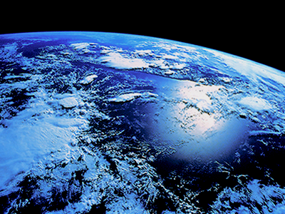
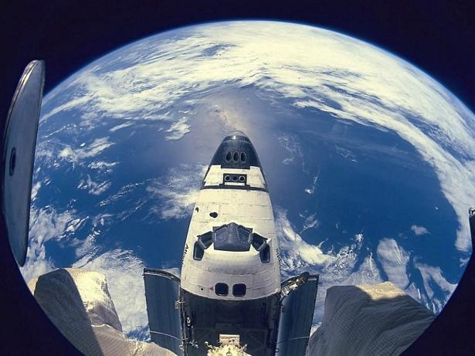
The Exosphere
This is outer space!!
Exo means out side.

Slide 10
Air Pressure
Air Pressure – measure of the force with which air molecules push on a surface.
As altitude (height) , air pressure .
Atmosphere is held around earth by GRAVITY. Gravity pulls gas molecules in the atmosphere toward the Earth’s Surface causing AIR PRESSURE

Slide 11
Air pressure is the strongest at Earth’s surface because more air is ABOVE YOU!!!

