Slide 1
Germany

Slide 2
Objectives
I can identify the key physical features of Germany. (7.3.spi.10)
I can examine Germany’s history (key events and people) and identify its form of government. (7.4.1)
I can identify Germany’s economic contributions worldwide. (7.2.1)
Directions: Make sure to make 4 sections for your notes: 1) geography, 2) History (timeline of major events), 3) key people 4) Economy (i.e. major products/exports)

Slide 3
Focus Question
What role does engines and jeans play in our lives?

Slide 4
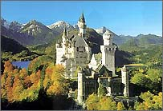
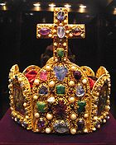
Germany

Slide 5
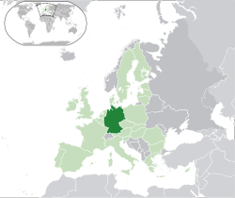
Germany in Dark Green

Slide 6
I. Germany
It is about the size of Montana and it lies in the heart of Europe.
Black Forest is known for its scenery and its wood products.
Danube River is an important waterway.

Slide 7
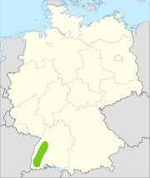
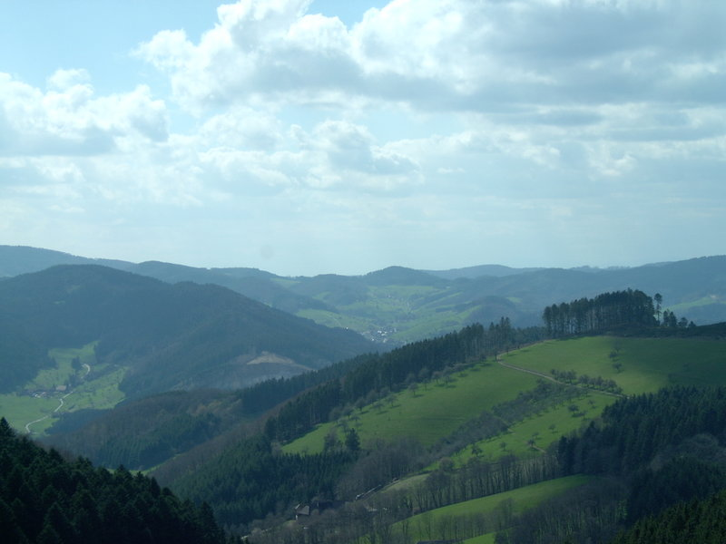
Black Forest

Slide 8
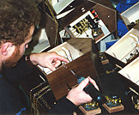
Clock-making is huge in Germany especially around the Black Forest Ex: Cuckoo Clock

Slide 9
Danube River

Slide 10
Berlin, Germany: capital

Slide 11
Bradenberg Gate: A symbol of Berlin and Germany

Slide 12
I. Germany
During the 1500s, a monk by the name of Martin Luther worked to reform the Catholic church.
His main problem was the buying of sins to the church.
He nailed the 95 Theses on Oct 31,1517 to Wittenberg Church

Slide 13
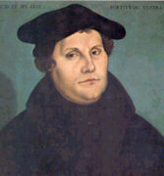
Martin Luther

Slide 14
Statue of Martin Luther in Berlin, Germany

Slide 15
95 Theses were nailed to

Slide 16
Wittenberg Church

Slide 17
I. Germany
Western Germany has a place called Ruhr and it is an important industrial center. Production of iron ore and coal is important here.
Many battles have been fought here.

Slide 18
I. Germany
Germany has superhighways called autobahns.
Late 1800s, Otto von Bismarck united a group of territories into a nation-Germany.

Slide 19
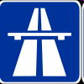
Autobahn in Germany: NO SPEED LIMIT

Slide 20
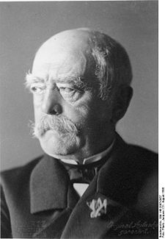
Otto von Bismark: founder of Germany (united in 1871)

Slide 21
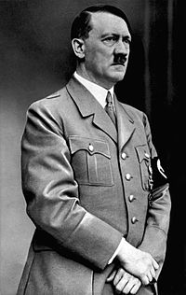
Adolph Hitler: Takes power in 1933

Slide 22
I. Germany
A great horror occurred in Germany during WWII called the Holocaust.
Adolf Hitler lead a slaughter of more than 6 million Jews and lead to the death of more than 10 million.

Slide 23
Holocaust in Auschwitz May 26, 1944 (one of the Most Deadliest Concentration Camps)

Slide 24
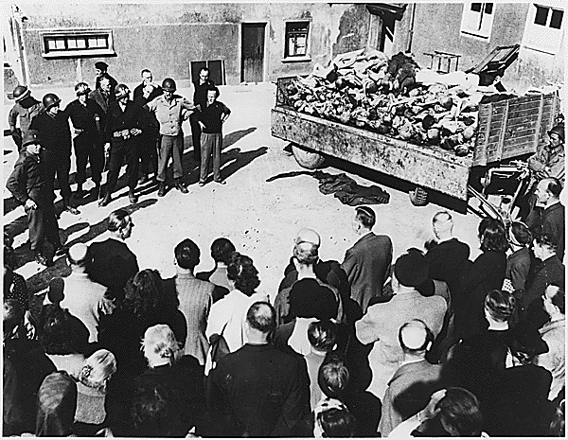
Empty Gas Cans used to gas those in the concentration camp in Auschwitz

Slide 25
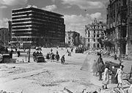
Berlin, Germany in ruins after WWII

Slide 26
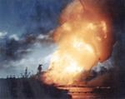
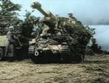
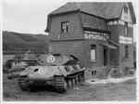
May 1945 End of WWII

Slide 27
Berlin Wall

Slide 28
I. Germany
Following WWII, Germany was divided in 1961 into the East and West.
East Germany became Communist. West Germany became a Democracy.
1989 Germany came together as a whole.

Slide 29
I. Germany Today
Government: Federal Republic with an elected president. (Just like the United States).,
Work continues to improve the economic gap between the east and west.
Population: 82.5 Million
90% live in Urban Areas

Slide 30
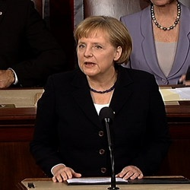
Chancellor Angela Merkel (germany’s Current President)

Slide 31
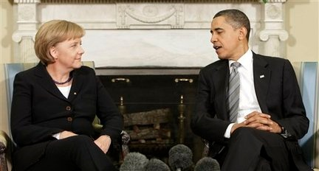
Chancellor Merkel with Presidents Bush and Obama

Slide 32
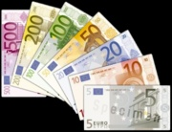
Germany’s Economy

Slide 33
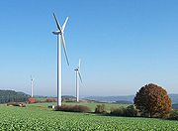
Germany is on the cutting edge of renewable energy It has the world’s largest wind farm and solar power capacity

Slide 34
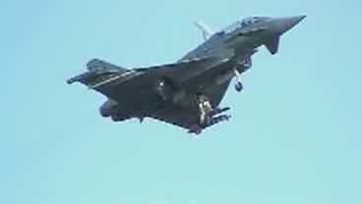
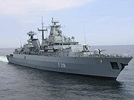
Germany is well-known for engineering and technology

Slide 35
Car Companies from Germany

Slide 36
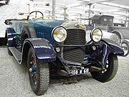
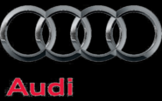
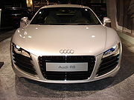
Audi

Slide 37
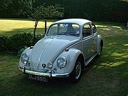
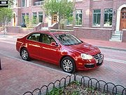
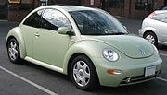
Volkswagen

Slide 38
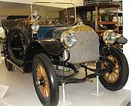
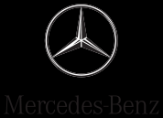
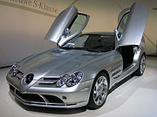
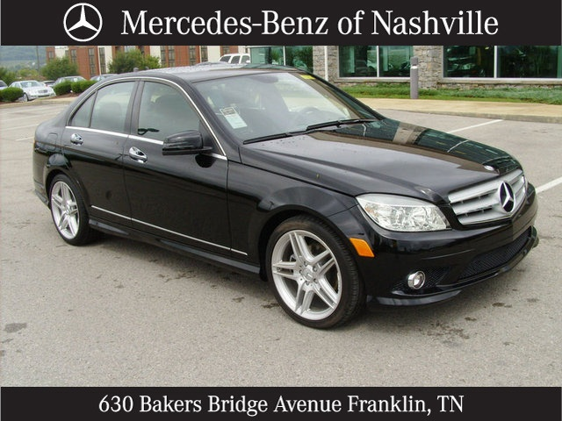
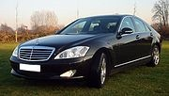
Mercedes-Benz

Slide 39
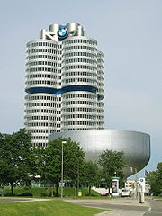
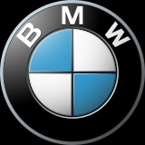
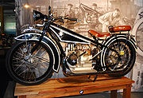
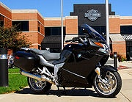
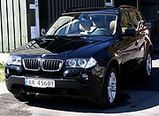
BMW

Slide 40
Key People in Germany’s Past and Present

Slide 41
Martin Luther: Protestant Reformation

Slide 42
Otto von Bismark

Slide 43
Hitler

Slide 44
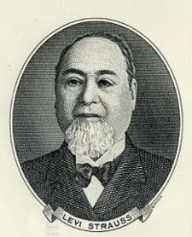
Levi Strauss

Slide 45
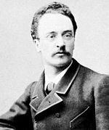
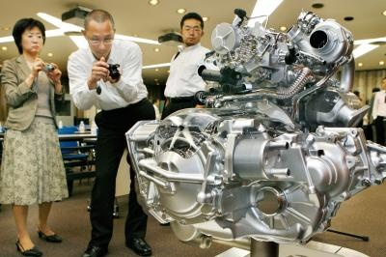
Rudolf Christian Karl Diesel

Slide 46
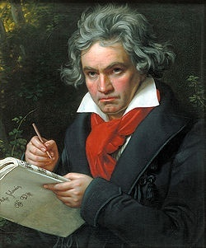
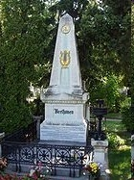
Ludwig van Beethoven: Germany

Slide 47
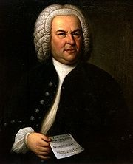
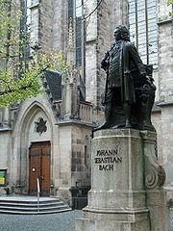
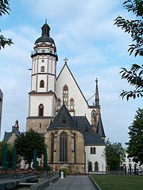
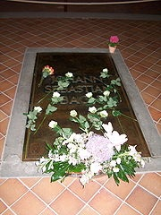
Johann Sebastian Bach

Slide 48
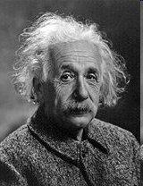
Albert Einstein

Slide 49
Atomic Bomb Invented by Einstein

Slide 50
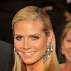
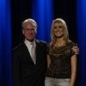
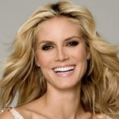
Heidi Klum

Slide 51
Dirk Nowitzki

Slide 52
Put the following items in the correct chronological order
Hitler gains power
Luther begins Protestantism
Berlin Wall Falls
Bismarck unites Germany
Germany divided

Slide 53
H.O. Questions
What choice would you have made if you were a Jew that had heard of the awful concentration camps?
Do you agree with the actions of Adolph Hitler? What is your opinion of him?

Slide 54
STOP!
Hasta La Vista, Baby!
Turn in Timeline place Germany notes in your binder.
DO NOT GO ON!!!!
Click

Slide 55
II.Switzerland

Slide 56
Objectives
I can describe the physical features of Switzerland and Austria. (7.3.spi.9 & 7.3.spi. 10)
I can identify key economic products of Switzerland and Austria. (7.2.spi.1)
I can summarize the cultures of Switzerland and Austria. (7.1.spi.1)
Directions: On your paper, make a T chart. One column should say Switzerland, the other Austria.

Slide 57
Focus question
In what way, does Arnold and Hitler relate?

Slide 58
Arnold

Slide 59
Hitler

Slide 60
Switzerland in Green

Slide 61
Federal Palace in Bern Bern is the capital of Switzerland

Slide 62
II.Switzerland
The Alps form most of the landscape of Switzerland, Austria, and Liechtenstein. These countries are called Alpine countries.
Switzerland remains neutral in wars.

Slide 63
Danube River

Slide 64
II. Switzerland
The Alps divides Western and Eastern Europe through Switzerland.
Most of the jobs in industries and farms are located in the plateau (Mittelland) between Jura and Alps

Slide 65
II. Switzerland
It has few natural resources ,yet it is a thriving industrial nation.
It has many ethnic groups and religions.

Slide 66
II. Switzerland
Four national languages: German, French, Italian, and Romansch. Most speak German, and many speak more than one language.
Government: federal republic.

Slide 67
Zurich, Switzerland

Slide 68
Wintertime view of Sent

Slide 69
View of the Mountains

Slide 70
Swiss Cheese: Exports 50,000 tons yearly

Slide 71
Swiss Chocolate

Slide 72
Swiss Army Knifes

Slide 77
Breitling Watch Company

Slide 78
International Red Cross: Headquarters is located in Switzerland

Slide 79
Folkloric Dance

Slide 80
Roger Federer

Slide 81
Actress Rene Zellweger’s Father is Swiss

Slide 82
III. Austria

Slide 83
Austria’s Location in Orange

Slide 84
Austria’s Flag

Slide 85
Vienna, Austria Capital of Austria

Slide 86
III. Austria
It is one of Europe’s largest countries. Austrian Empire ruled central Europe from late 1200s to the early 1900s.
Alps cover 3/4 of land area in Austria.
Very mountainous

Slide 87
III. Austria
The mountains in Austria provide valuable timber and hydroelectric power.
Minerals: iron ore, timber, and coal
Attract millions of tourist each year to enjoy hiking & skiing

Slide 88
Danube River in Austria

Slide 89
III. Austria
Most of the people live in cities and towns
Jobs: manufacturing or service industries
90 % follow the religion of Roman Catholic; Vienna is the capital and largest city.

Slide 90
Hitler was from Austria

Slide 91
Vienna’s Opera House

Slide 92
UN Building in Austria

Slide 93
Vienna, Austria Parliament Building

Slide 94
Hermesvilla

Slide 95
Rathaus

Slide 96
Wolfgang Puck

Slide 97
Franz Ferdinand: Assassination Started WWI

Slide 98
Home to Arnold

Slide 99
Johann Strauss: Austria

Slide 100
Wolfgang Mozart: Austria

Slide 101
Focus question
How does Arnold and Hitler relate?

Slide 102
Answer
Both relate to one of the countries in this lesson.
Arnold=Austria
Hitler= Germany but he is from Austria too

Slide 103
Homework: Complete guided reading 12.2 “Europe’s Heartland”
Clink

