Slide 1
Exploring Real Numbers

Slide 2
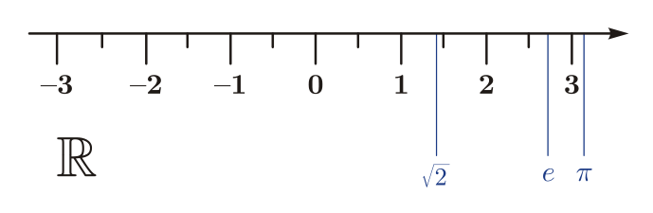
About Real Numbers
"Real Numbers" are all the numbers that we deal with in math class and in life!
Real Numbers can be thought of as all the points that fall along a number line.

Slide 3
Real Numbers (R)
all numbers that are points on a number line

Slide 4
Let's be rational...or irrational!
Real numbers can be divided into two categories:
REAL NUMBERS
Irrational
Rational

Slide 5
Rational Numbers (ℚ)
any number that can be written as a fraction
1/2 3.5 9/3 -1/3
any decimal that terminates (ends) or repeats
0.325 -0.3333333...

Slide 6
Real Numbers (R)
all numbers that are points on a number line
Rational Numbers (Q)
any number that can be written as a fraction (includes terminating and repeating decimals)
-3.7
½

Slide 7



Irrational Numbers (I)*
any number that can not be written as a fraction (as a ratio of 2 whole numbers)
a non-repeating, non-terminating decimal

Slide 8
Real Numbers (R)
all numbers that are points on a number line
Irrational Numbers (I*)
any number that cannot be written as a fraction. Non-terminating, non-repeating decimals
Rational Numbers (Q)
any number that can be written as a fraction (includes terminating and repeating decimals)
-3.7
½
√ 2
π
0.010010001...

Slide 9
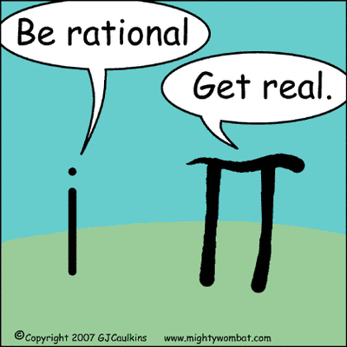

Slide 10
Rational Number Breakdown
Rational numbers can be divided into 3 categories
REAL NUMBERS
Irrational
Rational
Integers
Whole Numbers
Natural Numbers

Slide 11
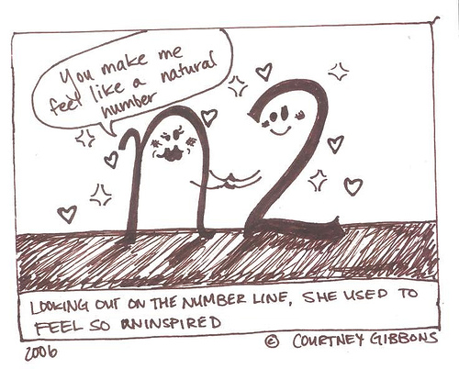
Natural Numbers (ℕ)
Natural numbers are the counting numbers. They are probably the first numbers you learned about.
1, 2, 3, 4, 5 ...

Slide 12
Real Numbers (R)
all numbers that are points on a number line
Irrational Numbers (I*)
any number that cannot be written as a fraction. Non-terminating, non-repeating decimals
Rational Numbers (Q)
any number that can be written as a fraction (includes terminating and repeating decimals)
-3.7
½
Natural Numbers (N)
counting numbers
√ 2
π
1, 2, 3, 4, 5 ...
0.010010001...

Slide 13
Whole Numbers (W)
Add a zero to the Natural Numbers and you'll get the set called "Whole Numbers"
0, 1, 2, 3, 4, 5 ...

Slide 14
Real Numbers (R)
all numbers that are points on a number line
Irrational Numbers (I*)
any number that cannot be written as a fraction. Non-terminating, non-repeating decimals
Rational Numbers (Q)
any number that can be written as a fraction (includes terminating and repeating decimals)
-3.7
½
Whole Numbers (W)
counting numbers and zero
Natural Numbers (N)
counting numbers
π
0
√ 2
1, 2, 3, 4, 5 ...
0.010010001...

Slide 15
Integers (ℤ)
Integers include all counting numbers, their opposites, and zero
The opposites of the counting numbers are simply the negatives
... -5, -4, -3, -2, -1, 0, 1, 2, 3, 4, 5 ...

Slide 16
Real Numbers (R)
all numbers that are points on a number line
Irrational Numbers (I*)
any number that cannot be written as a fraction. Non-terminating, non-repeating decimals
Rational Numbers (Q)
any number that can be written as a fraction (includes terminating and repeating decimals)
-3.7
½
Integers (Z)
whole numbers and their opposites
-21
Whole Numbers (W)
counting numbers and zero
-4
Natural Numbers (N)
counting numbers
π
0
√ 2
1, 2, 3, 4, 5 ...
0.010010001...

Slide 17
Real Numbers (R)
all numbers that are points on a number line
Irrational Numbers (I*)
any number that cannot be written as a fraction. Non-terminating, non-repeating decimals
Rational Numbers (Q)
any number that can be written as a fraction (includes terminating and repeating decimals)
-3.7
½
Integers (Z)
whole numbers and their opposites
-21
Whole Numbers (W)
counting numbers and zero
-4
Natural Numbers (N)
counting numbers
π
0
√ 2
1, 2, 3, 4, 5 ...
0.010010001...

Slide 18
Pop Quiz!
Name the set(s) of numbers to which each number belongs.
  -1

Slide 19
Pop Quiz!
Name the set(s) of numbers to which each number belongs.
  -1
      (integers, rational numbers)

Slide 20
Pop Quiz!
Name the set(s) of numbers to which each number belongs.
  -1
      (integers, rational numbers)
  -4.8

Slide 21
Pop Quiz!
Name the set(s) of numbers to which each number belongs.
  -1
      (integers, rational numbers)
  -4.8
      (rational numbers)

Slide 22
Pop Quiz!
Name the set(s) of numbers to which each number belongs.
  -1
      (integers, rational numbers)
  -4.8
      (rational numbers)
  -20/4

Slide 23
Pop Quiz!
Name the set(s) of numbers to which each number belongs.
  -1
      (integers, rational numbers)
  -4.8
      (rational numbers)
  -20/4
      (integers, rational numbers)

Slide 24
Pop Quiz!
Name the set(s) of numbers to which each number belongs.
  -1
      (integers, rational numbers)
  -4.8
      (rational numbers)
  -20/4
      (integers, rational numbers)
  7

Slide 25
Pop Quiz!
Name the set(s) of numbers to which each number belongs.
  -1
      (integers, rational numbers)
  -4.8
      (rational numbers)
  -20/4
      (integers, rational numbers)
  7
      (natural numbers, whole numbers, integers, rational numbers)

Slide 26
Exploring Real Numbers
THE END

