Slide 1
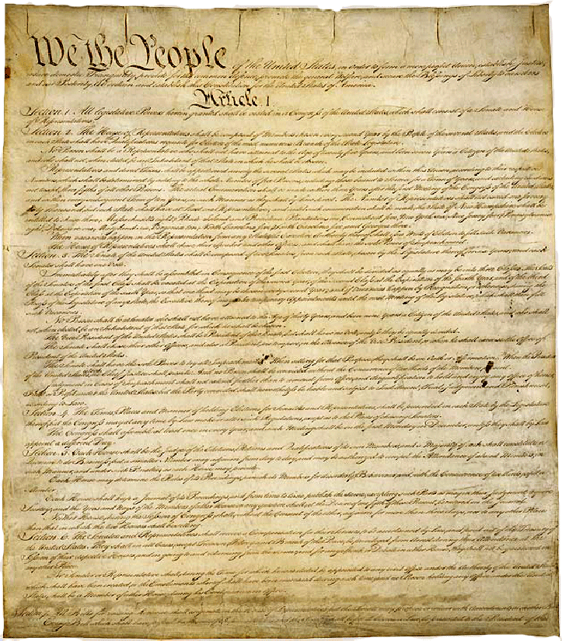
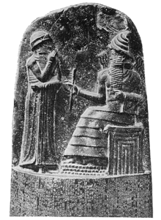

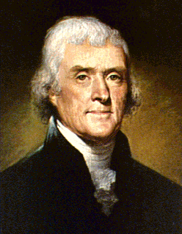
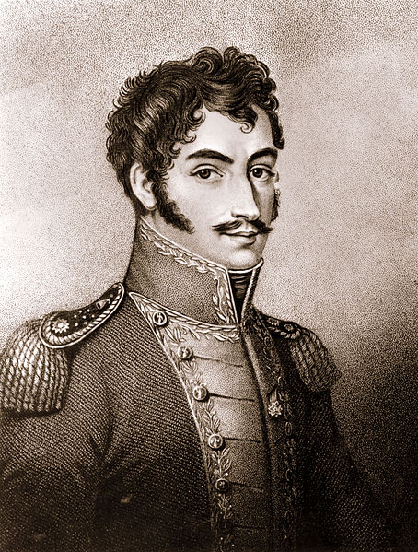
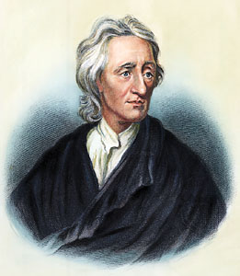
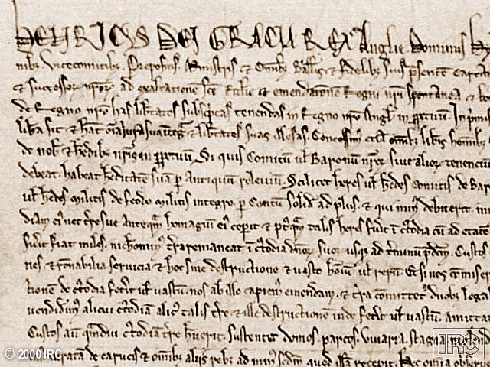
Key Documents in
World History

Slide 2
Hammurabi’s Code
“If a noble man puts out the eye of another noble man, his eye shall be put out.
If he breaks another noble man’s bone, his bone shall be broken.
If he puts out the eye of a commoner or breaks the bone of a commoner, he shall pay one silver mina.
If he puts out the eye of a man’s slave or breaks the bone of a man’s slave, he shall pay one-half of its value.”

Slide 3
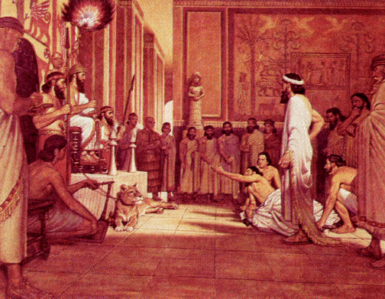
Hammurabi’s Code
Retaliation was key.
An “Eye for an eye and a tooth for a tooth.”
If a Judge ruled poorly, he paid a fine and lost his position.
Hammurabi's Court

Slide 4
Moses and the
10 Commandments
In 1250 BC, Moses went up on Mt. Sinai, and received God’s laws.
The 10 Commandments was a covenant agreement between God and the Hebrews.

Slide 5
Moses, the Lawgiver
No other gods.
No worshipping idols or images.
Do not take the Lord’s name in vain.
Remember the Sabbath and keep it holy.
Honor your father and mother.
6. You shall not murder.
7. No adultery
8. You shall not steal.
9. No false testimony against your neighbor.
10. You shall not covet.

Slide 6


Connections to America’s
Legal Traditions
Thou Shall Not Kill/Murder
Still against the law today
Rationale to differentiate between Murder, Capital Punishment, Warfare, Self-Defense and Manslaughter.
Thou Shall Not Bear False Witness Against thy Neighbor
Oath-taking -In American courts of law – most people promise to tell the truth – so help them God.
The penalty for lying under oath is called perjury, and it carries a penalty – fine/jail time.
Thou Shall Not Steal
Stealing is still against the law. Crimes of theft were also categorized according to how severe they were.

Slide 7
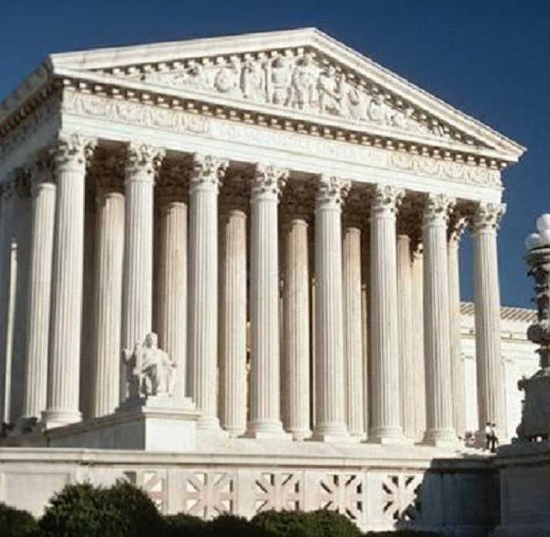
Links to the American Legal System
Mosaic law had procedures to be followed as the law was applied and enforced.
“Due Process” or procedural laws are a key part of the American legal system.
The U.S. Supreme Court above
Notes:
Second, there were striking parallels between some of Hammurabi's statutes and those of Moses in the Book of the Covenant. For example, in citing the law for personal injury, Hammurabi's statute 206 states: "If a man wound another accidentally in a quarrel with a stone or his fist, and oblige him to take his bed, he shall pay for the lass of his time and for the doctor's." The law of Moses, for the same offense, is remarkably similar (Exodus 21:18-19).
The similarity between these and a few other statutes left the way open for some critical scholars to postulate that the Mosaic law in the Bible was derived from the Code of Hammurabi. Most scholars, however, have abandoned this theory, since further research has shown that, in ancient times, there were codes of law in various countries. Some of these were even older than Hammurabi's stele.
Furthermore, Mosaic law moved beyond the Code of Hammurabi, or any of the ancient law codes, because it is grounded in the worship of one God. The ethical principles in the law of Moses spring from love toward the one true God. Such love demands that one also love fellow human beings, whom God made in his image. Moses thus talks about human sin and our responsibility to God in resisting sin. Hammurabi and other ancient law-givers, however, do not address this issue.
Hammurabi's law code is exclusively civil and criminal. Moses' law code, on the other hand, begins with spiritual principles — love toward God and humans — from which the civil and criminal laws are derived. From its stress on the motive of love, the law of Moses demanded more humane treatment for slaves, gave higher regard for womanhood, and placed greater value upon human life in general. The priority given to such spiritual values made the Mosaic law unique among all the ancient law codes.
http://www.gci.org/bible/torah/steal10

Slide 8
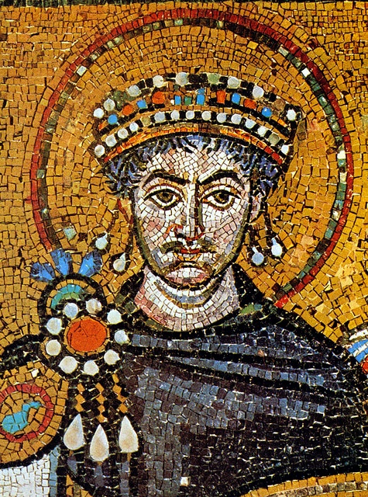
Emperor Justinian
Justinian tried to re-conquer the Western Empire of Rome. He oversaw the building of Hagia Sophia.
He is best remembered for his code of laws called Justinian’s Code.
Mosaic of Emperor Justinian.

Slide 9
Justinian’s Code of Laws
Justinian set up a panel of 10 legal experts, who brought together over 400 years worth of Roman laws and traditions into one single, uniform book of laws and commentaries known as Justinian's Code.
Justinian's Code contained 4 separate works –
The Code - which contained 5,000 Roman laws the Byzantines still found relevant and useful.
The Digest - which quoted and summarized the opinions of Rome's greatest legal minds. It served as a useful guide for judges deciding a case.
The Institutes - a textbook that taught law students how to use the laws.
The Novella or New laws that were passed after 534 AD.
The Code discussed the Law for Individuals and the Natural Laws that a person is born with and entitled to. This idea of the Natural Laws of Man will be picked up again by political philosophers such as John Locke and Thomas Jefferson, who will argue for the natural laws or unalienable laws a man is born with, "that among these are life, liberty and the pursuit of happiness."

Slide 10
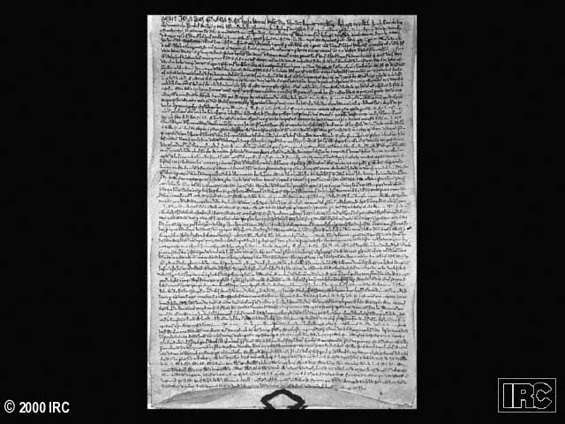
Magna Carter (Great Charter)
English nobles forced John to sign
Gave political rights to nobles and limited King’s power
Notes:
Probably born May 31, 1162

Slide 11
Magna Carta (Great Charter)
No taxation without representation.
Right to a jury trial.
Protection under the law.
Notes:
E15

Slide 12
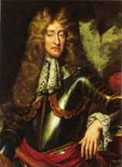
English Bill of Rights
Signed in 1689 by William and Mary of Orange when they were invited to become monarchs of England after the Glorious Revolution and the ousting of James II.
Notes:
E15

Slide 13
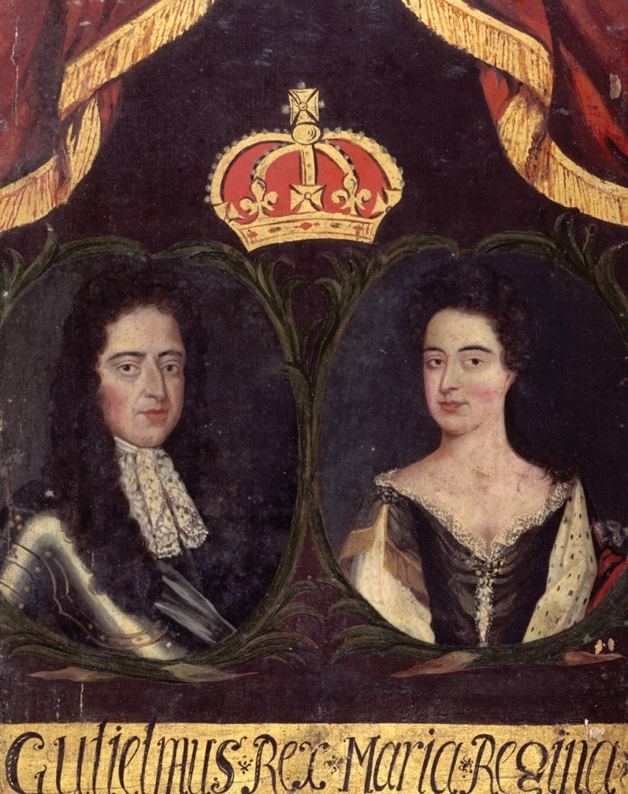
English Bill of Rights
No taxation without representation by Parliament
Freedom to petition the king
Freedom to bear arms
Freedom to elect members of Parliament
Notes:
E15

Slide 14
English Bill of Rights
Freedom of speech in Parliament
Freedom from cruel and unusual punishments
Freedom from fines and forfeitures without trial
Notes:
E15

Slide 15

Declaration of Independence
July 4, 1776
We hold these truths to be self-evident, that all men are created equal, that they are endowed by their Creator with certain unalienable Rights, that among these are Life, Liberty and the pursuit of Happiness. —
Thomas Jefferson

Slide 16
Declaration of Independence
That to secure these rights, Governments are instituted among Men, deriving their just powers from the consent of the governed, — That whenever any Form of Government becomes destructive of these ends, it is the Right of the People to alter or to abolish it, and to institute new Government, laying its foundation on such principles and organizing its powers in such form, as to them shall seem most likely to effect their Safety and Happiness

Slide 17
US Constitution
Separation of powers- legislative, executive, judicial
Republic with President
Bill of Rights added

Slide 18
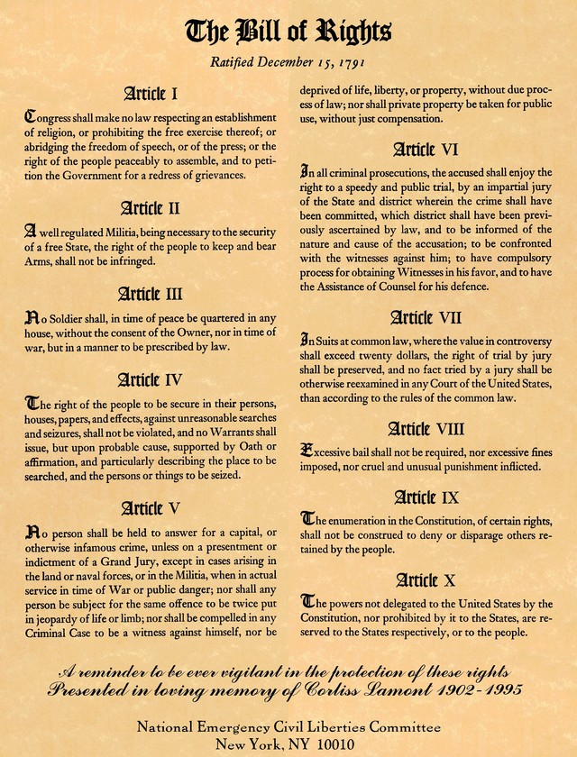
Bill of Rights
Added 1789
Freedom of speech, press and religion.
No cruel and unusual punishment.

Slide 19
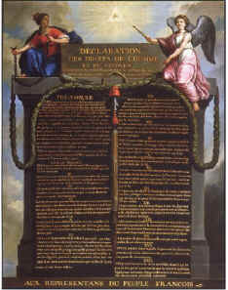
Declaration of the Rights of Man and the Citizen
Natural rights affirmed: liberty, property, and resistance to oppression.
Freedom and equal rights for all men.
Free speech and free press.
Notes:
E15

Slide 20
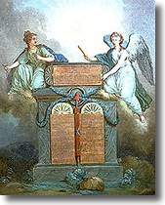
Declaration of the Rights of Man and the Citizen
Ended tax exemptions.
Access to public office based on talent.
All citizens may take part in the making of laws.
Notes:
E15

Slide 21

Independence in Haiti
1788 – The National Assembly in France published the Declaration of the Rights of Man and the Citizen , declaring all men free and equal.
Haiti - Oct. 1790 – Vincent Oge, a wealthy free man of color demanded the right to vote from the colonial governor who refused.

Slide 22
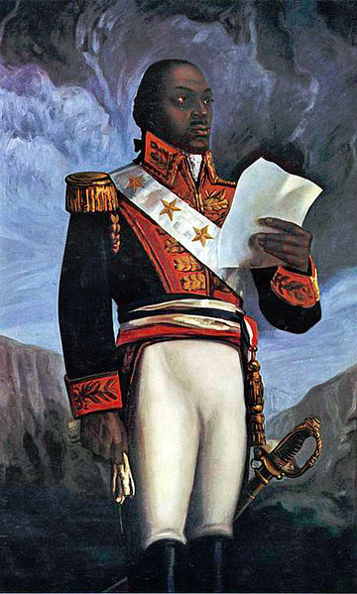
Independence in Haiti
Oge led a rebellion against the governor. It quickly spread.
1791 – 100,000 Enslaved Africans rose in revolt under the leadership of Toussaint L’Ouverture.
A former slave, Toussaint rose to become a skilled general and leader.
Gen. Toussaint L’Ouverture

Slide 23
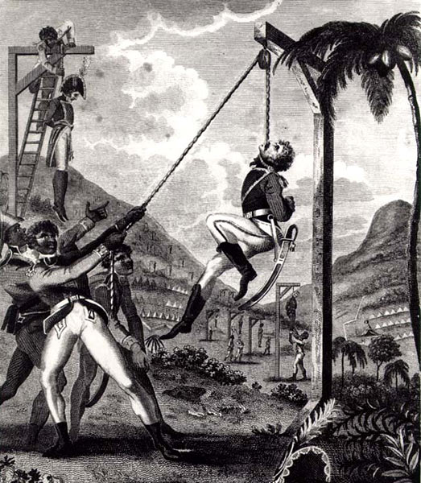
Independence in Haiti
A new leader in Haiti arose – Jean-Jacques Dessalines fought for 2 years before successfully expelling the French from the island of Haiti in 1803.
In 1804, Dessalines declared the colony of Haiti an independent country.
It was the 1st black colony to free itself from European control.
“Revenge taken by the black army.” 1805

Slide 24
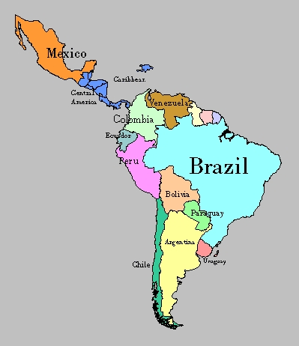
Independence in Latin America
1819-1830 -Simon Bolivar ruled over a republic of Colombia that included the countries of: Colombia, Venezuela, Ecuador, N. Peru, and Brazil.
To this day, he is considered the patriarch of these nations.
Simon Bolivar above

Slide 25
Independence in Latin America
“Americans [Spanish Americans born in Spanish America but who have European descent] today, and perhaps to a greater extent than ever before, who live within the Spanish system occupy a position in society no better than that of serfs destined for labor, or at best they have no more status than that of mere consumers. Yet even this status is surrounded with galling restrictions, such as being forbidden to grow European crops, or to store products which are royal monopolies, or to establish factories of a type the Peninsula itself does not possess.
Simon Bolivar, “Jamaica Letter,” 1815

Slide 26

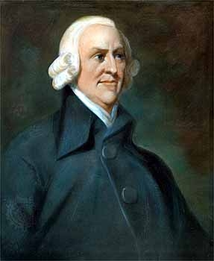
Adam Smith, Wealth of a Nation
...every individual necessarily labours to render the annual revenue of the society as great as he can. He generally, indeed, neither intends to promote the public interest, nor knows how much he is promoting it. By preferring the support of domestic to that of foreign industry, he intends only his own security; and by directing that industry in such a manner as its produce may be of the greatest value, he intends only his own gain, and he is in this, as in many other cases, led by an invisible hand to promote an end which was no part of his intention.

Slide 27
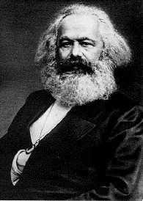
Karl Marx
“In place of the old bourgeois society, with its classes and class antagonisms, we shall have an association in which the free development of each is the condition for the free development of all.”
Marx & Engels, Communist Manifesto1848)
Karl Marx

