Slide 1
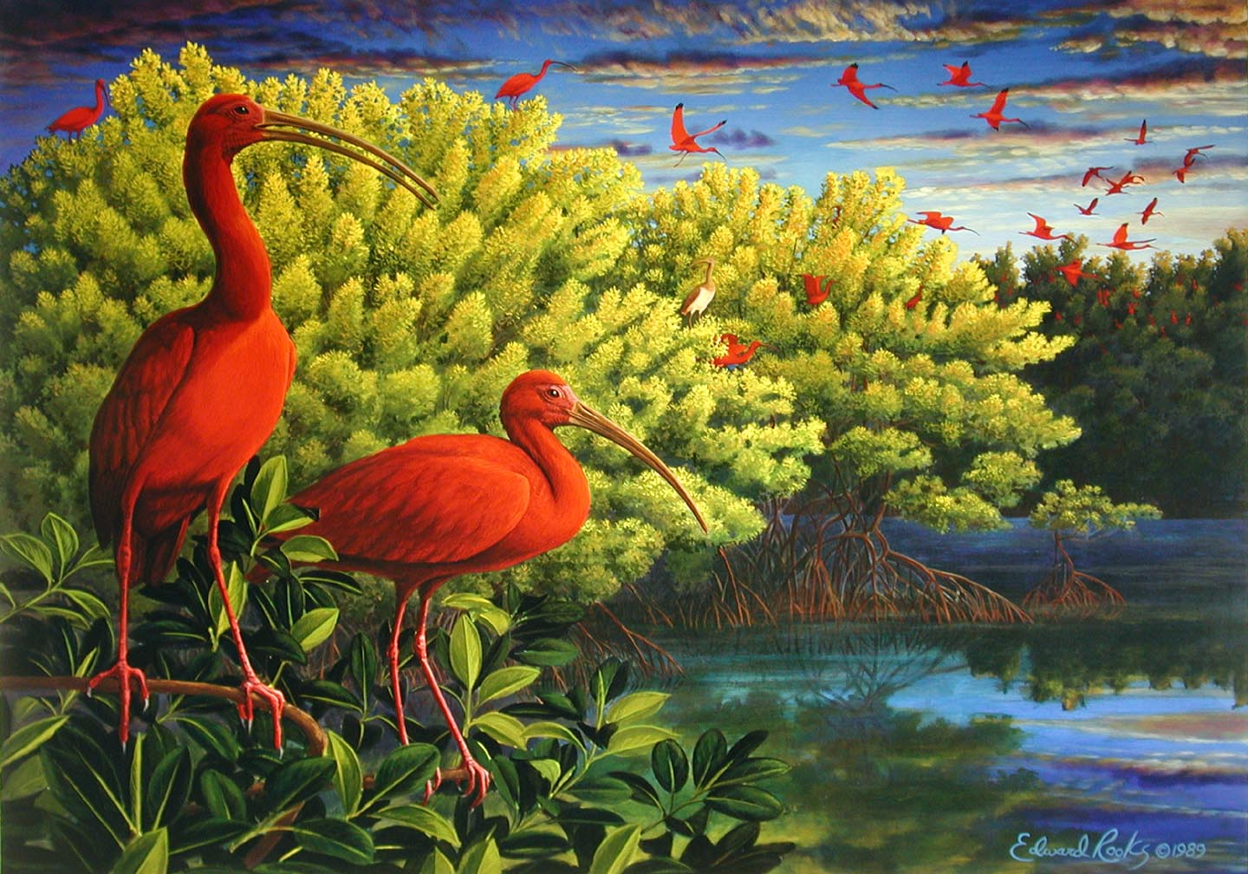
The Scarlet Ibis

Slide 2
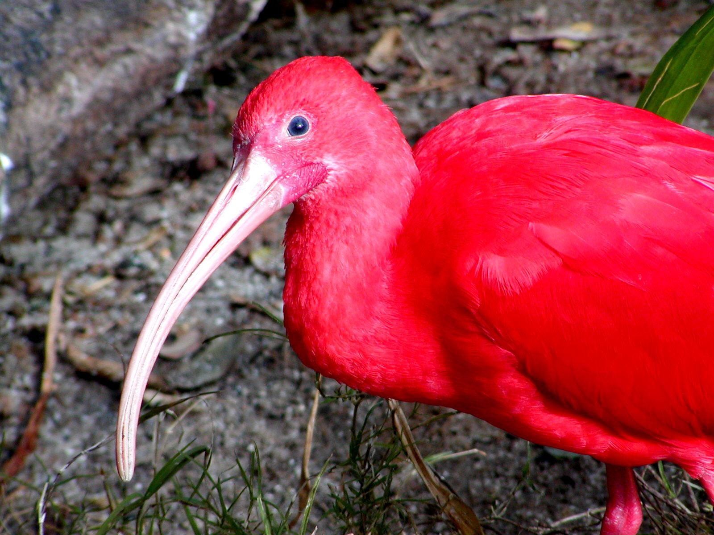
The Scarlet Ibis by Hurst
Scarlet Ibis

Slide 3
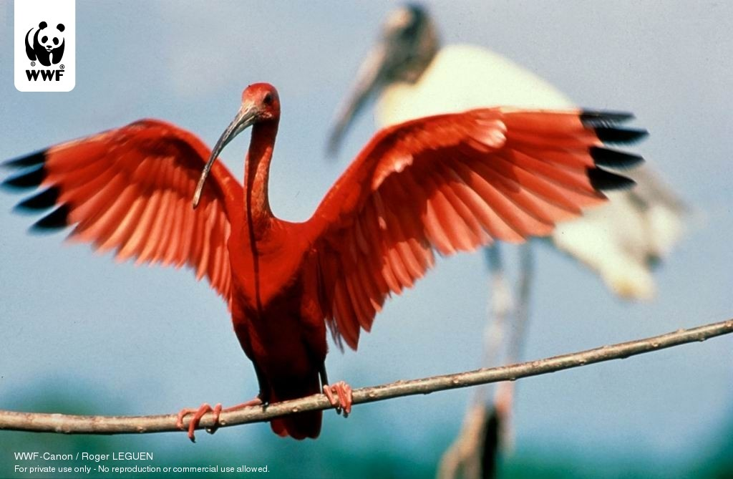
The Scarlet Ibis by Hurst
Scarlet Ibis

Slide 4
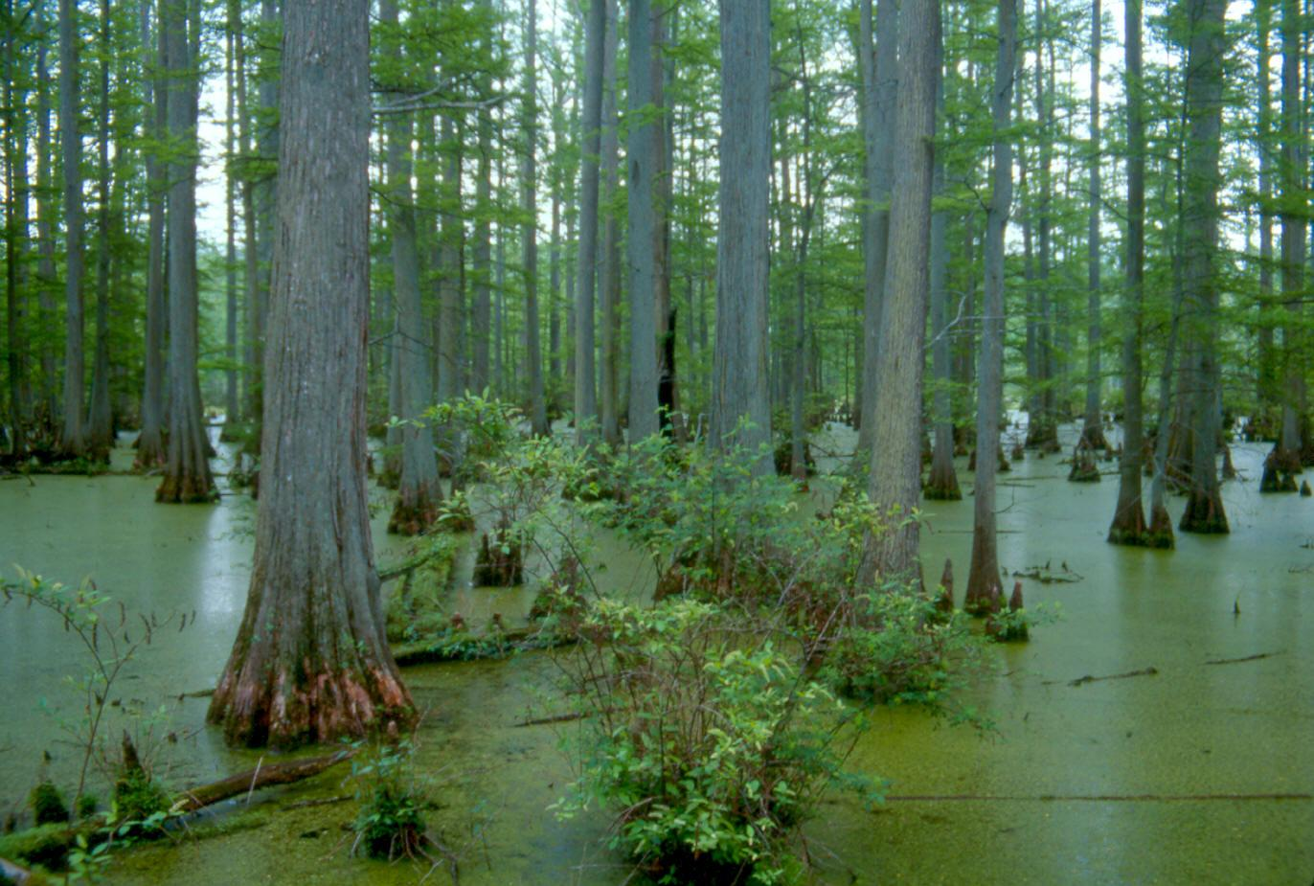
The Scarlet Ibis by Hurst
Florida Swamp

Slide 5
Notes
symbol- An object, person, place or experience that exists on a literal level but also represents something else, often something abstract.
foil- A character who provides a strong contrast to another character. A foil may emphasize another character’s distinct traits or may make another character look better by comparison.

Slide 6
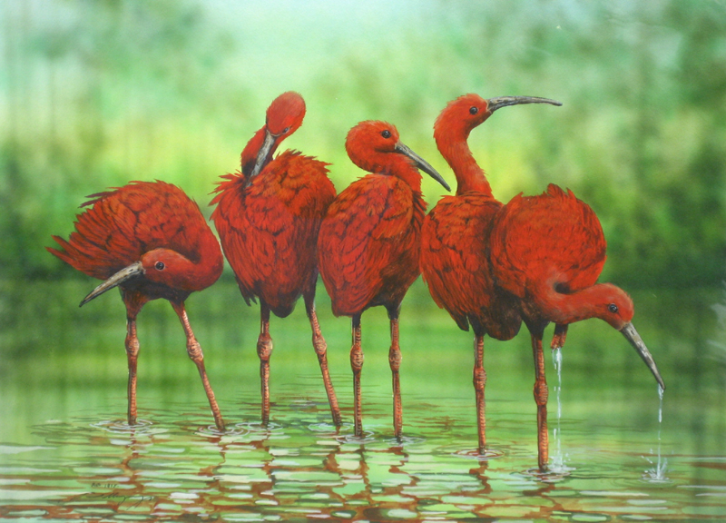
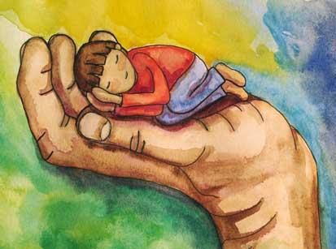
Overview
Plot at a Glance
The story focuses on the troubled relationship between two young boys: the narrator and his mentally and physically disabled brother, Doodle.
His brother wishes he had a normal functioning brother and sometimes even has dark thoughts about murdering him

Slide 7
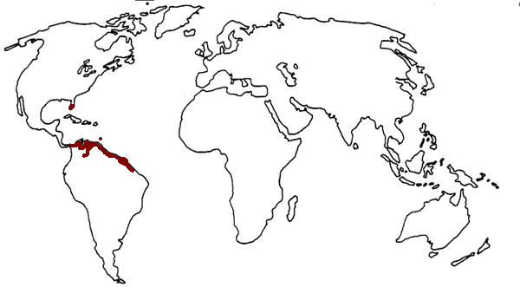
Literary Focus
Symbols
The Scarlet Ibis
Connections Between The Scarlet Ibis and Doodle
In the course of the story, Doodle becomes symbolically identified with a rare and beautiful Scarlet Ibis
1a.The Scarlet ibis, an exotic bird that does not belong in the narrator's region, land in their backyard
1b.Doodle is forced to do things that he should not have to try to do and is forced out of his element
2a.The red bird falls from the tree it is in, and lands dead at the feet of Doodle’s family
2b.Forces of out of his element Doodle loses his color (as a Scarlet Ibis would) and his health declines
The shaded area of the map highlights the region populated by the Scarlet Ibis

Slide 8
Theme
Theme- The central message of a literary work. The theme is the author’s insight about life or human nature. The theme of a story is different than the subject.
For example:
“Rules of the Game”
is about chess, but its theme addresses the generation gap that exists between mother and daughter.

Slide 9
How is theme expressed?
Stated theme
Implied theme
The author expresses the theme directly.
For example: Fables have a stated theme.
Most literary works have an implied theme which is revealed gradually through a variety of literary elements, including plot, character, setting, figurative language, and point of view.

Slide 10
PreAP “The Scarlet Ibis” Discussion
Symbols
The Scarlet Ibis
Red
The Barn Loft
The Clove of the Seasons
The Grindstone
Themes
Memory and the Past
Guilt and Blame
Pride
Love
Man and the Natural World
Transformation

Slide 11
PreAP Essay assignment
Quote
2 pages
“I did not know then that pride is a wonderful terrible thing.”
Think of a time in your own lives when you have experienced pride in a negative way. Write a personal narrative in which you describe an event in your own lives involving a negative effect of pride.

