Slide 1
Zimbabwe How to Destroy an Economy
Source: Some graphics and information extracted from “Hyperinflation in Zimbabwe,” by Janet Koech, 2011, Federal Reserve Bank of Dallas – Annual Report 2011

Slide 2
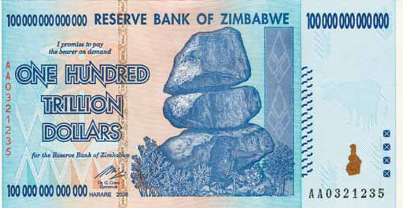
The historic Zimbabwean $100 trillion bill
When Zimbabwe attained independence in 1980, Z$2, Z$5, Z$10 and Z$20 denominations had circulated for three decades, until ultimately the government land reform policies mismanaged a once successful economy and created spiraling inflation. The Zimbabwean government issued the Z$100 trillion bill in early 2009, the largest denomination of currency ever issued. Subsequent higher denominations were issued as inflation further eroded purchasing power in the economy.

Slide 3
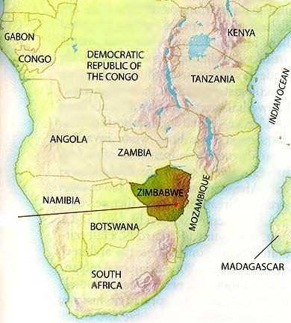
Where is Zimbabwe?
Located in the southern region of Africa
At 150,871 square miles it is about the size of California
Population was estimated to be 12.7 million in 2011
Notes:
Zimbabwe is located in the southern region of the African continent and is bounded to the north by Zambia, to the east by Mozambique, to the south by South Africa and to the west by Botswana and the Caprivi Strip of Namibia. At 390,757 square kilometers (150,871 square miles), Zimbabwe is about the size of California, with a population the United Nations estimated at 12.7 million in 2011. Its capital is Harare. The nation’s name is derived from historical structures called “Great Zimbabwe” (houses of stone), the largest stone sculptures in Africa after the pyramids of Egypt.

Slide 4
Land Reform Policies
Following a brutal civil war, the country operated with “majority rule” after elections in 1980.
Robert Mugabe and his ZANU won a landslide victory
Land issues, which the liberation movement had promised to solve, re-emerged as the main issue for the ruling party around 1997
Despite majority rule and the existence of a "willing-buyer-willing-seller" land reform since the 1980s, whites made up less than 1% of the population but held about 70% of the most arable land
Mugabe began to redistribute land to supporters in 2000 with a compulsory land redistribution policy

Slide 5
Tobacco Production
Tobacco production data provides insight into how bad was the decline in agricultural output following land reform in 2000

Slide 6
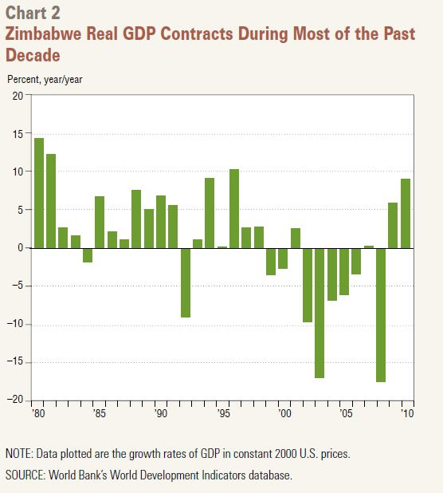
Overall GDP Effects
It has been a rocky road since majority rule and elections in 1980, but the last ten years are the worse
Notes:
This is real output, so it is MV/P. It is decreasing in the later periods, so P is increasing faster than MV. Why? Because merchant’s formed expectations about government policy and acted to prevent a re-distribution of their resources by increasing prices faster and faster. When such inflation occurs, V also incrases as Money becomes a “hot potato” that no one wants to hold.

Slide 7
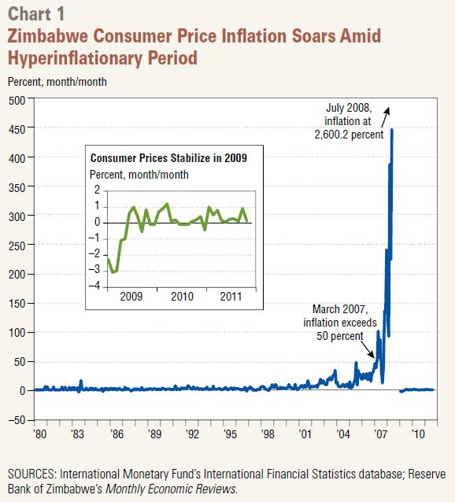
The Consequence is Hyperinflation
This episode of hyperinflation was among the worse in history based on official data.
Unofficial estimates place it as the worse

Slide 8
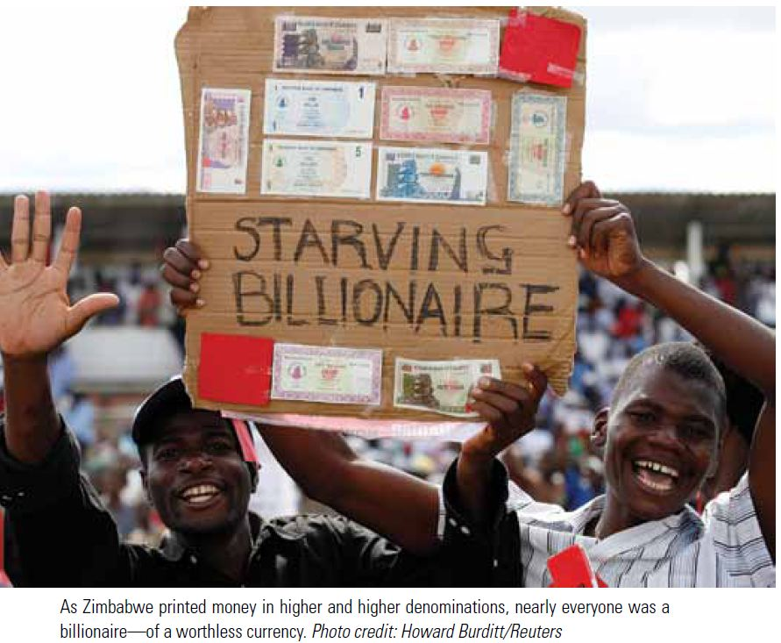
Not Much Solace in Misery

Slide 9
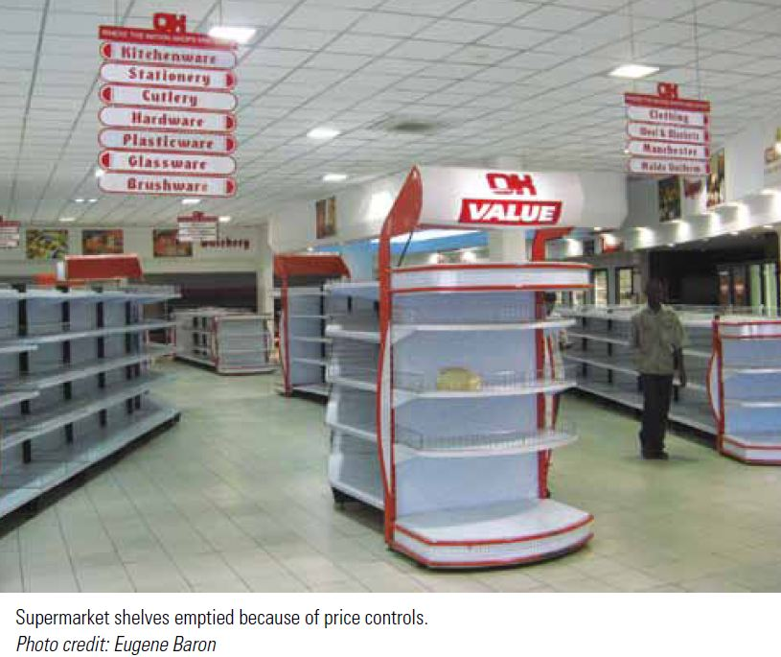
Hard to Find Food!

Slide 10
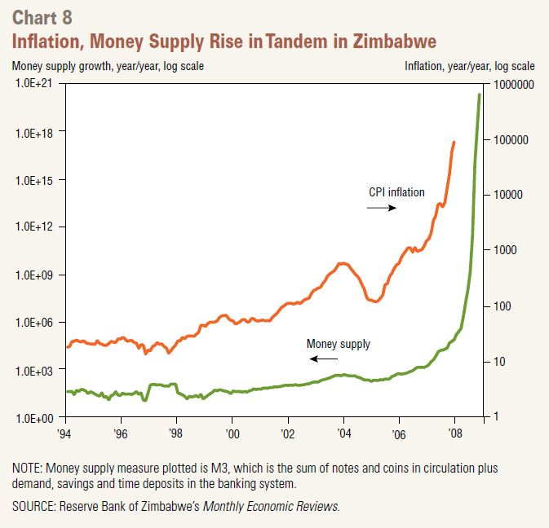
Cause and Effect – Part 1
Economists have repeatedly shown that the growth of money and the CPI are highly correlated

Slide 11
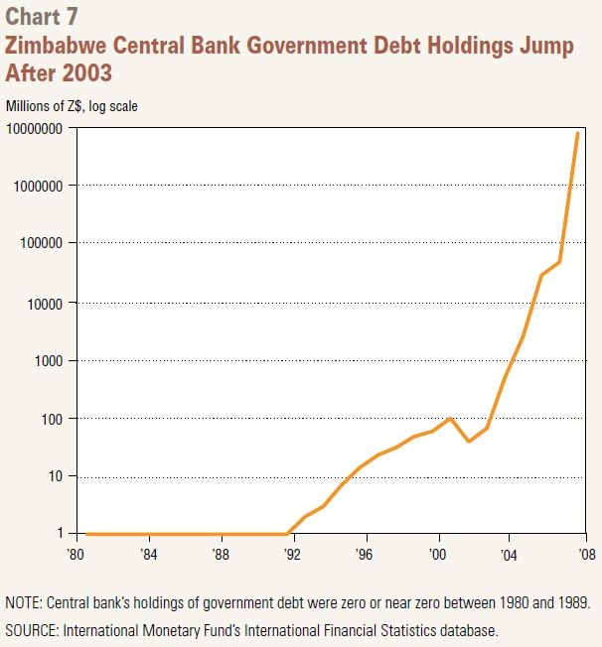
Cause and Effect – Part 2
The Zimbabwe Central Bank prints money to buy the government debt, as tax collections fall dramatically with the GDP decline

Slide 12
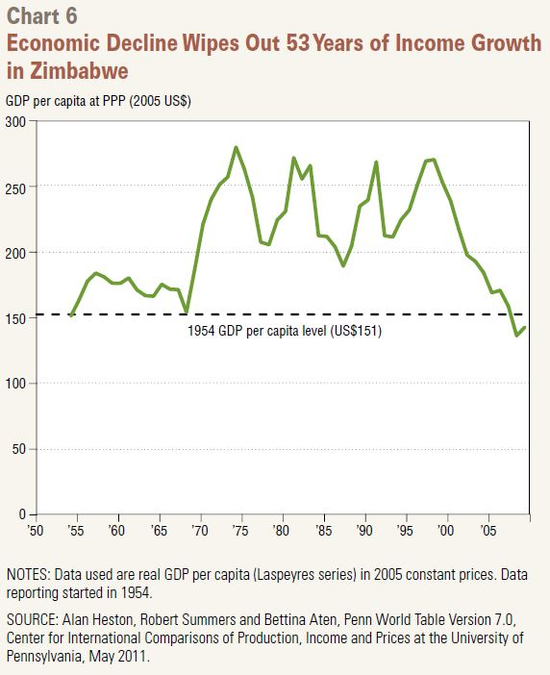
Wiping Out a History of Growth
Perhaps the excess creation of money should be an economic crime given its awful effects on a population

Slide 13
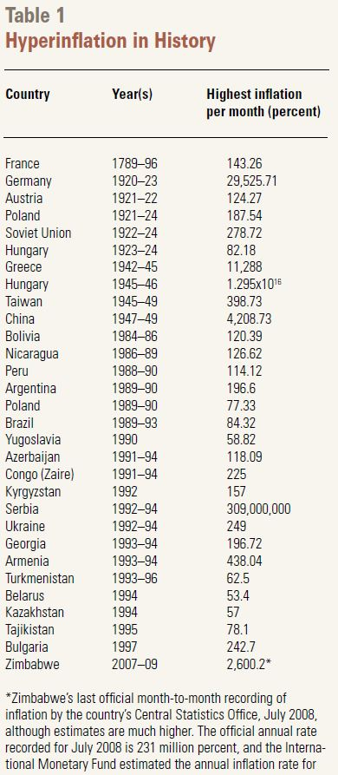
The Official History

Slide 14
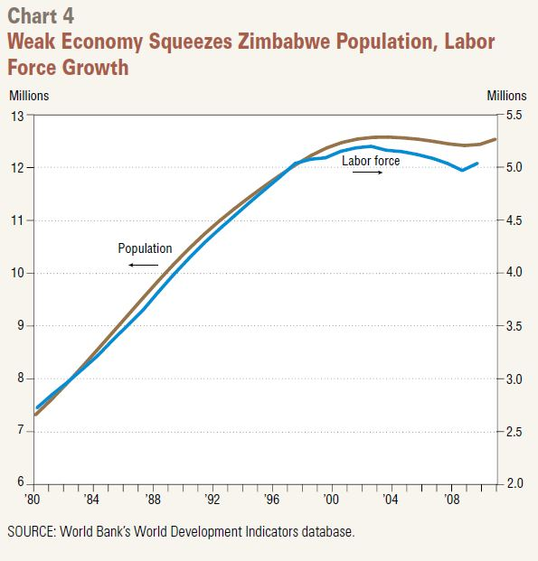
Would You Stay or Go?
Notice how population growth flattens and then declines after 2000
If you cannot eat, you cannot stay

Slide 15
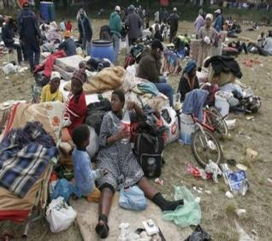
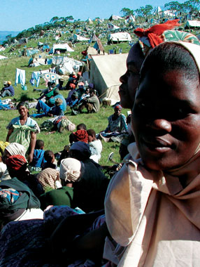
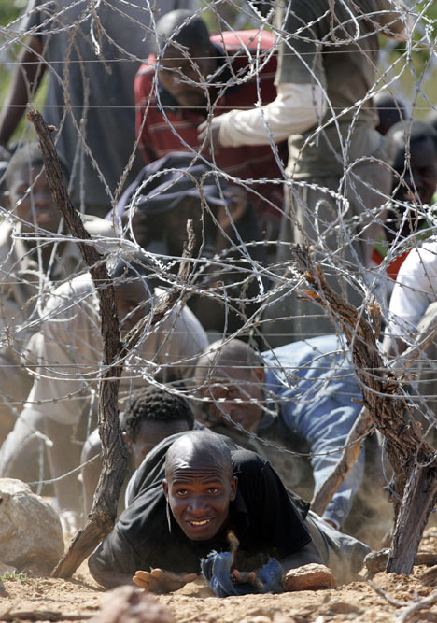
Refugees
Refugee life is a constant trial to survive and find food

Slide 16
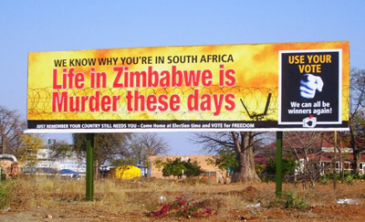
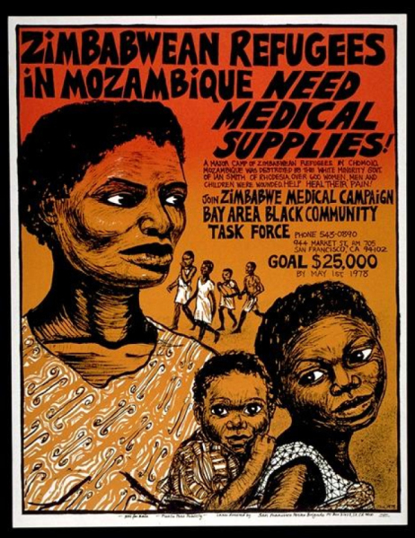
Refugees
Zimbabwe is an example of how difficult it is to transfer political power
Some Organizations try to help
Notes:
Note the “USE YOUR VOTE” part of the billboard….”We can all be winners again.” The is a Pareto optimal claim; that is, there are gains from trade, but not if there is no trade.

Slide 17
Solving hyperinflation
In late 2008, the Zimbabwe dollar was replaced in transactions by widespread dollarization (using the US Dollar) amid hyperinflation
The official demise of the currency occurred in February 2009, when authorities established a multicurrency system
Transactions in hard foreign currencies were authorized, and payment of taxes in foreign exchange was subsequently allowed

Slide 18
The Stability Results
Zimbabwe experienced an economic rebound from 2009-12 following the introduction of the multiple currency system
Real GDP growth averaged 11.0% per year. However, GDP growth decelerated sharply from 10.6% in 2012 to 4.5% in 2013 and 3.1% in 2014.
Inflation decreased to 4.5% in 2013 and has remained low.

Slide 19
Conclusion
Zimbabwe is the first country to experience hyperinflation in the 21st century.
Hyperinflation is rare and often associated with wars, regime change and unstable political and economic environments where revenues are insufficient to cover government expenditures and printing more currency becomes a solution.
Notes:
Extracted from “Hyperinflation in Zimbabwe,” by Janet Koech, 2011, Federal Reserve Bank of Dallas – Annual Report 2011

Slide 20
More Conclusions
Hyperinflation produces adverse impacts—wealth and savings are wiped out within months, and prices of basic commodities become out of reach to many, especially those on fixed incomes.
Governments often implement price controls in an attempt to control inflation, but this leads to shortages as producers opt for alternative markets
Economies also resort to barter and trade in foreign currencies when the home currency has lost its value.
Notes:
Extracted from “Hyperinflation in Zimbabwe,” by Janet Koech, 2011, Federal Reserve Bank of Dallas – Annual Report 2011

