Slide 2
10
The World of Lodging

Slide 3
Objectives
Describe the characteristics of full-service hotels, limited service properties, and specialty accommodations.
List the three types of hotel ownership.
Explain what a hotel management company does.
Explain what an affiliation group is and what it does.
continued

Slide 4
Objectives
Describe the three size categories of lodging properties.
Assess the relationship between level of service and price of a hotel room.
Contrast the six major market segments in the lodging industry.
Describe the role of foodservice in many lodging properties.

Slide 5
Types of Lodging Businesses
Lodging businesses can be organized by level of service:
full-service hotels
limited-service properties
specialty accommodations

Slide 6
Full-Service Hotels
Full-service hotels
are usually two or more stories high
have guest rooms arranged along shared inside hallways
offer a full range of services, including concierge service
usually charge the highest prices
continued

Slide 7
Full-Service Hotels
Convention hotels—may include exhibit halls and convention centers to accommodate trade shows
Luxury hotels—highest level of service
Resort hotels —located at resort properties
Extended-stay hotels —may offer suites of more than one room
Condominium hotels—may be time-shares

Slide 8
Limited-Service Properties
Limited-service properties
charge lower prices and provide fewer services than a full-service hotel
may offer pools and continental breakfast
include motels, limited-service hotels, and budget hotels

Slide 9
Specialty Accommodations
Types of specialty accommodations include
conference centers
lodges
bed-and-breakfast operations
hostels
campgrounds

Slide 10
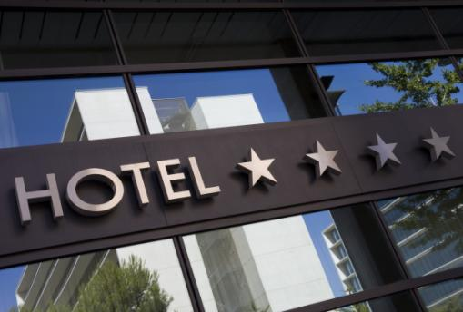
Location
Lodging properties can be categorized by their location:
center city
suburban
highway
airport
resort
©pfcross/Shutterstock.com

Slide 11
Ownership and Management
An independent lodging property is a single-unit business
A chain has multiple units with the same brand name and ownership
A franchise is a unit of a chain that has an outside owner
The owner of a lodging property may be an individual, a partnership, or a corporation
continued

Slide 12
Ownership and Management
Ownership and management are not the same thing
Hotel management is the day-to-day running of the hotel
One person or company may own the hotel and another person or company may manage it

Slide 13
Affiliation
A referral system is a group of independent hotels that uses a central office for reservations and marketing
A referral system is also called an affiliation group or a consortium

Slide 14
Size and Price
A small lodging property has 1 to 50 rooms
A mid-size property has 51 to 200 rooms
A large property has 201 or more rooms
Lodging properties may be categorized as premier, moderate, or budget
Properties may also be categorized as luxury, first-class, mid-range, economy, and budget
continued

Slide 15
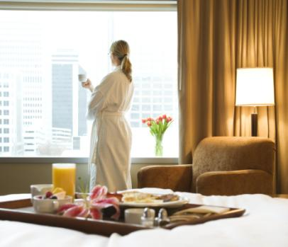
Size and Price
A higher level of service usually means a higher price
Prices vary by location; lodging in cities is usually more expensive
©iofoto/Shutterstock.com

Slide 16
Room Rates
Rack rate is the official rate for one night’s lodging
Room rate is the price actually charged to a guest for one night’s lodging
Hotel managers change rates in response to competition, seasonal demands, and economic conditions

Slide 17
Market Segments
Business
Conventions and meetings
Leisure
Budget
Extended-stay
Special (groups such as airlines that have made arrangements for low rates)

Slide 18
Target Market and Guest Mix
A target market is the market segment on which a lodging business focuses
Many lodging businesses seek to attract more than one segment
The guest mix is the percentage of each market segment that is staying at a lodging property

Slide 19
Functions in Lodging
Front office
Housekeeping
Purchasing and receiving
Management
Marketing and sales
Human resources
Accounting
Security
Safety and emergency procedures
Engineering

Slide 20
Lodging and Foodservice
A room rate that includes meals is called a meal plan
Full American Plan includes three meals a day
Modified American Plan includes two meals, usually breakfast and dinner
Continental Plan includes continental breakfast
European Plan means no meals are included

Slide 21
Lodging Concept
Lodging concept, which distinguishes one property from another; includes
theme
target market
décor
ambiance (feeling or mood)
level of service

Slide 22
Chapter 10 Review
Lodging businesses can be organized according to three levels of service. What are these?
full-service, limited-service, and specialty
The owner of a lodging property may be an individual, a partnership, or a(n) _____.
corporation
continued

Slide 23
Chapter 10 Review
A group of independent hotels that uses a central office for reservations and marketing is called a(n) _____.
referral system, affiliation group, or consortium
Would a hotel that has 60 rooms be categorized as small, mid-size, or large?
mid-size
continued

Slide 24
Chapter 10 Review
What is the difference between rack rate and room rate?
Rack rate is the official rate for one night’s lodging. Room rate is the price actually charged.
The market segment that a lodging business wants to attract is called its _____.
target market

