Slide 1
Important Scientists in Cellular Biology Unit 6-DNA Structure and Replication

Slide 2
Introduction to DNA

Slide 3
Matthias Schleiden 1804–1881
Contributed to cell theory (All living things are composed of cells.); worked with Theodor Schwann; studied plant tissues and determined that plants are made of cells; also realized the importance of the cell’s nucleus and felt it might relate to cell division

Slide 4
Theodor Schwann 1810–1882
Contributed to cell theory (All living things are composed of cells.); worked with Matthias Schleiden; discovered “Schwann cells” in the nervous system; studied animal cells/tissues especially muscular and nervous tissues; considered the founder of histology

Slide 5
Rudolf (Rudolph) Virchow 1821–1902
Contributed to cell theory (All cells arise from existing cells.); considered father of pathology; was an advocate for public health; applied cell theory to the spread of diseases in the human body

Slide 6
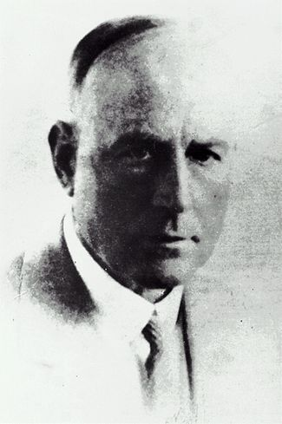
Frederick Griffith & Oswald Avery
Griffith did experiments trying to find a vaccine for pneumonia; he discovered that when harmless bacteria and a virulent (actively poisonous) bacteria were mixed some of the harmless bacteria became virulent, he called this transformation; Avery continued Griffith’s experiments and tried to find out what substance caused the transformation, he determined it was DNA that caused the transformation
1879–1941
1877–1955

Slide 7
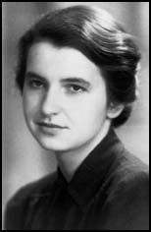
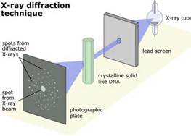
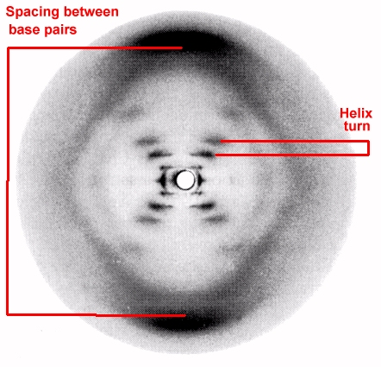
Rosalind Franklin
- X-ray photo of DNA.
(1952)

Slide 8
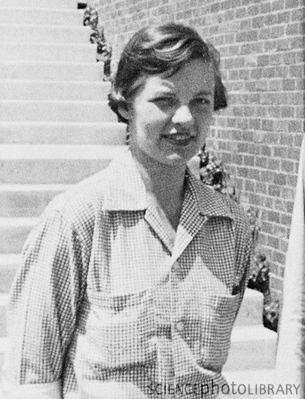
Alfred Hershey & Martha Chase
Conducted experiments (the “Hershey-Chase” experiments) to confirm the transformation principle; determined that DNA is the genetic molecule of inheritance not proteins.
1927–2003
1908–1977

Slide 9
Erwin Chargaff 1905–2002
Adenine and Thymine always join together
A T
Cytosine and Guanine always join together
C G
Courtesy of National Library of Medicine

Slide 10
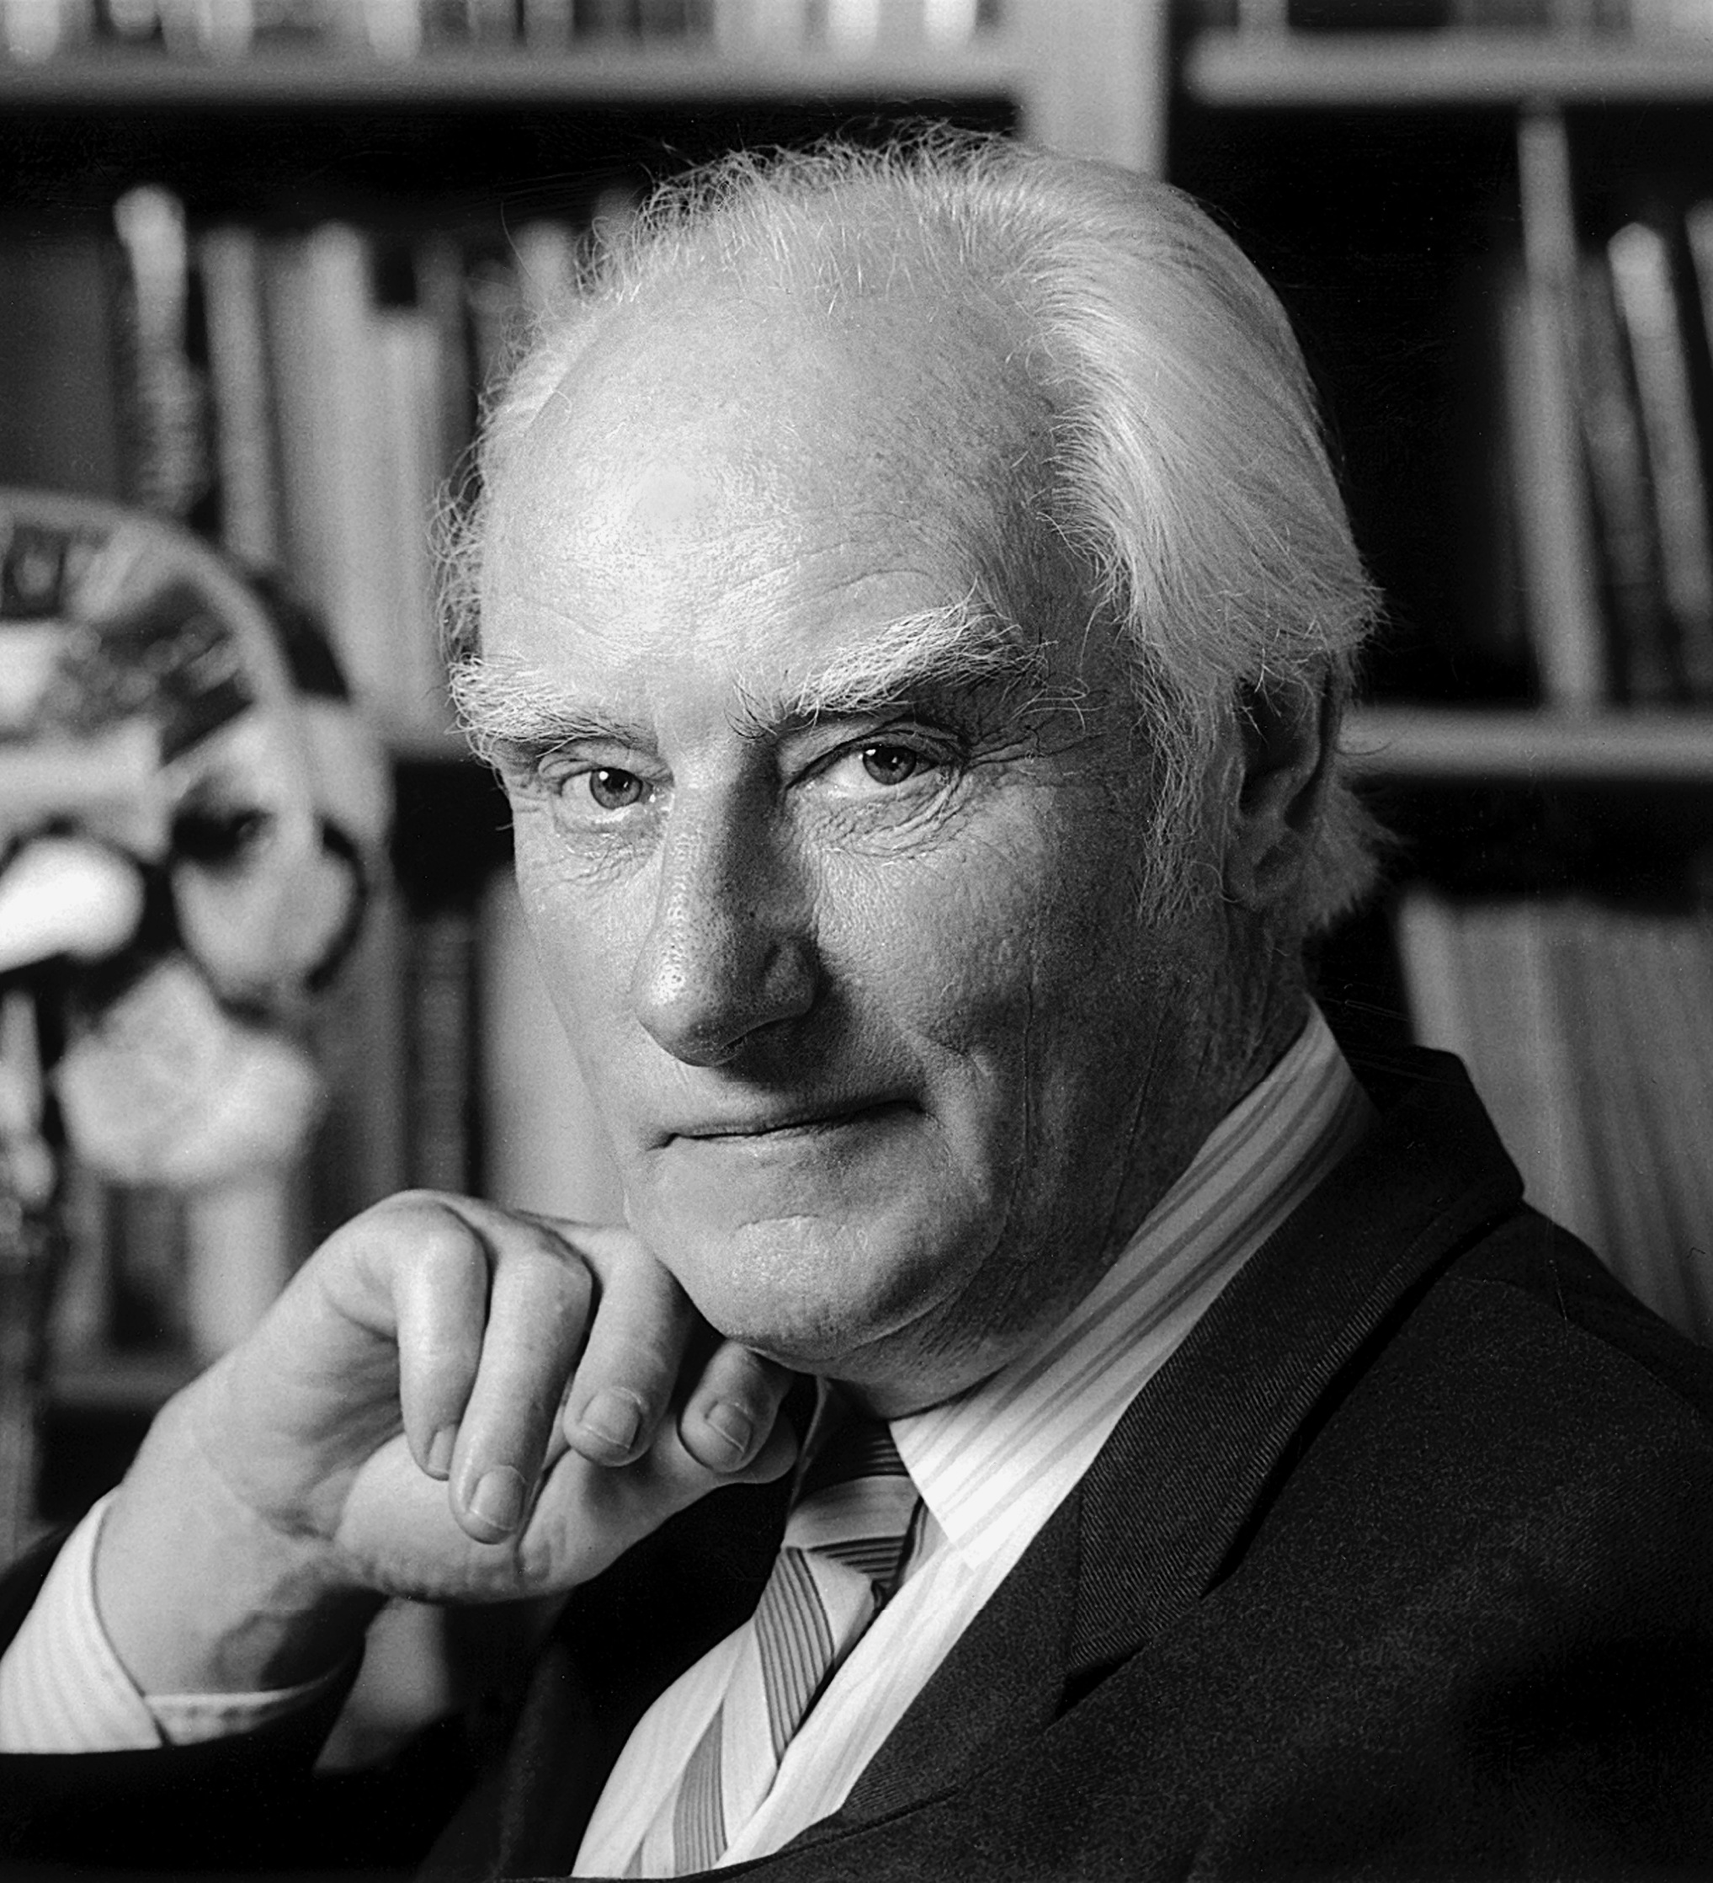
James Watson & Francis Crick
Discovered the double-helix structure of DNA (with the help of previous X-ray diffraction experiments by Rosalind Franklin and Maurice Wilkins).
animation
1916–2004
1928 - living

Slide 11
Watson & Crick proposed…
DNA was made of 2 long stands of nucleotides arranged in a specific way called the “Complementary Rule”
DNA had specific pairing between the nitrogen bases:
ADENINE – THYMINE
CYTOSINE - GUANINE

Slide 12
The Shape of the Molecule
DNA is a very long polymer.
The basic shape is like a twisted ladder or zipper.
This is called a double helix.
Notes:
{Show students a model of the double helix. Explain what a spiral is and a helix is.}

Slide 13
The Double Helix Molecule
The DNA double helix has two strands twisted together.
Notes:
We will take apart the DNA molecule to see how it is put together.
First, we will look at one strand.

Slide 14
All images courtesy of Wikimedia Commons unless otherwise noted. http://commons.wikimedia.org/wiki/Main_Page

