Slide 1
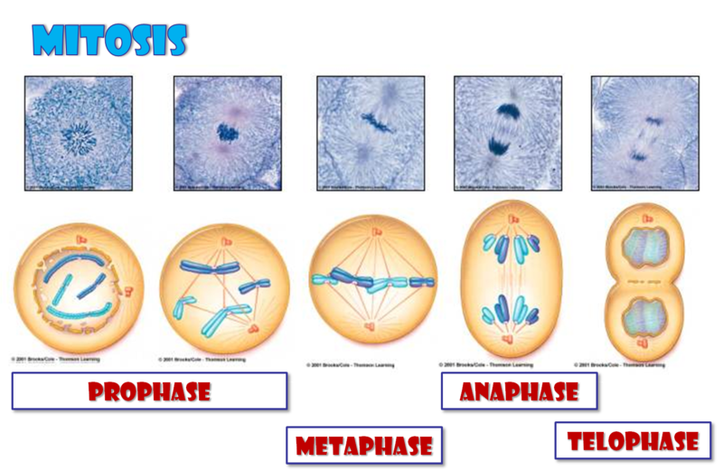
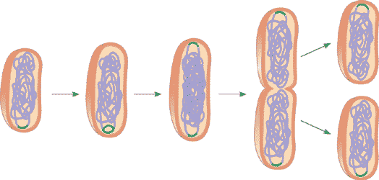
Cell Division vs Binary Fission

Slide 2
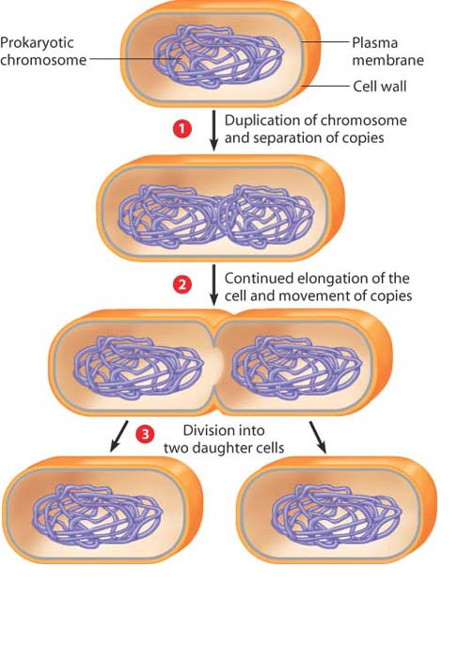
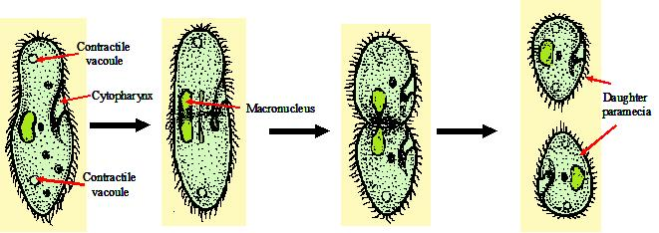
Binary Fission
("division in half")
is a kind of asexual reproduction.
Asexual reproduction is a mode of reproduction by which offspring arise from a single organism, and inherit the genes of that parent only
It is the most common form of reproduction in prokaryotes and occurs in some single-celled eukaryotes.
After replicating its genetic material, the cell divides into two nearly equal sized daughter cells. The genetic material is also equally split.
Bacteria (prokaryotic)
Paramecium (eukaryotic)

Slide 3
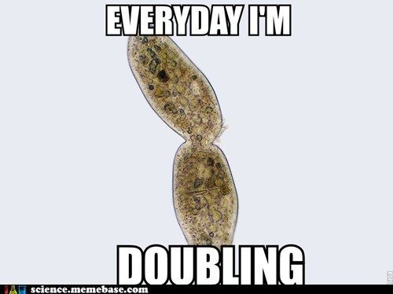
Binary Fission

Slide 4
Does not…
find biology teacher’s jokes funny

Slide 5
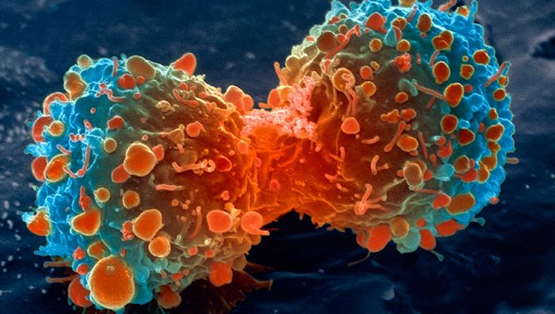
Cancer
What is it?

Slide 6
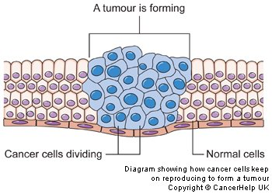
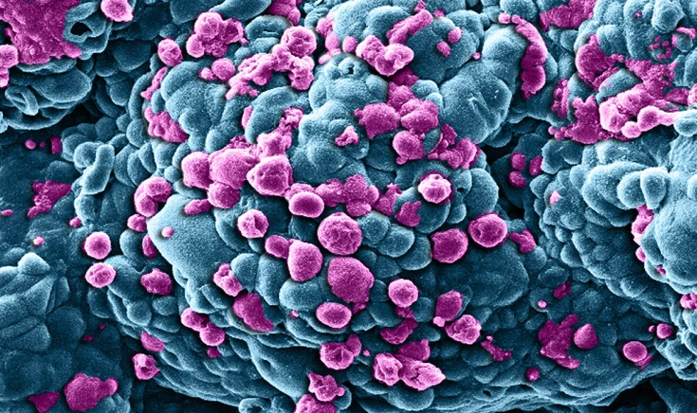
Cells Gone Wild
A disease in which abnormal cells divide uncontrollably and destroy body tissue
Cancer Animation
Cancer Animation 2
How Cells Divide and How Chemotherapy

Slide 7
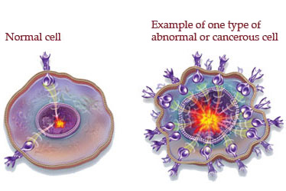
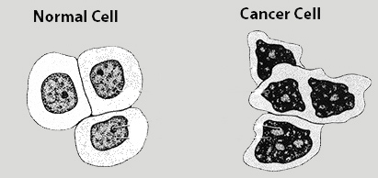

Slide 8
