Slide 1
Identifying Mutations
Unit 7 L 2

Slide 2
What is the true meaning of the word: Mutation?
It means to change

Slide 3
Are mutations bad/harmful?
Mutations can be harmful, helpful, or have no effect. It is a common misunderstanding that mutations are bad, but they are simply a change that may be good, bad, or neutral.

Slide 4
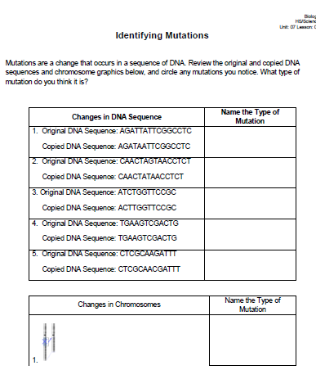
Identifying Mutations Activity
If you had to identify/name the type of mutation, what would you name each one?

Slide 5
