Slide 1
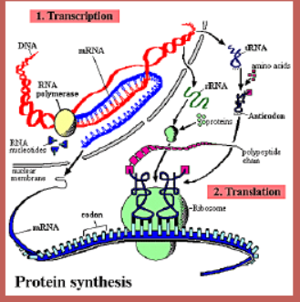
Protein synthesis
Making proteins

Slide 2
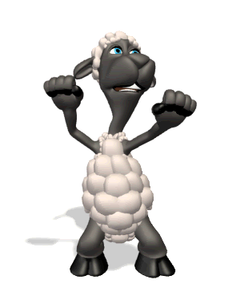
Review DNA and its concepts in a beat…
DNA Song

Slide 3
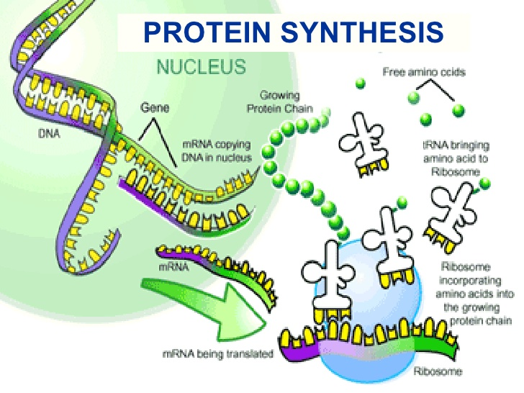
Introduction to Protein Synthesis

Slide 4
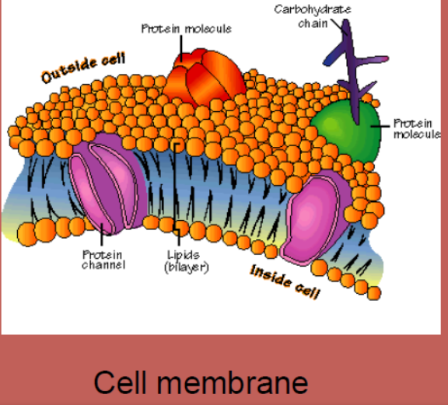
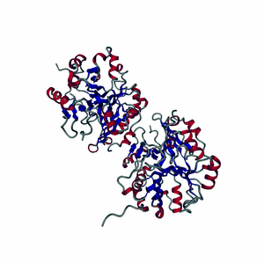
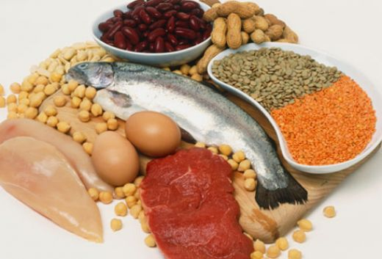
Why do we need proteins?
1. Cell Structure
Cell= 80% protein

Slide 5
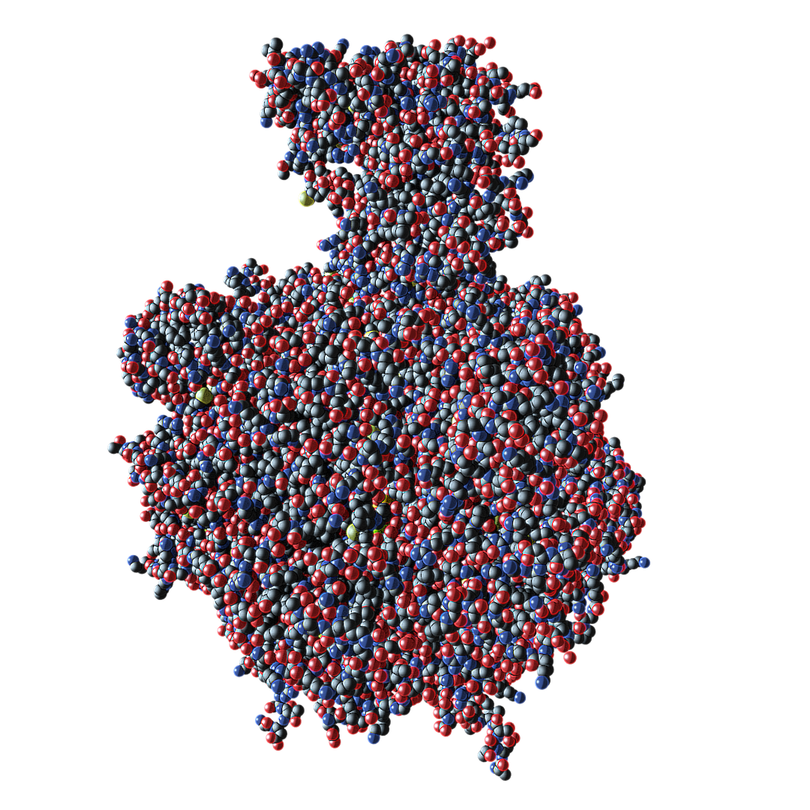
Why do we need proteins?
2. Cell processes
Hormones (signals)
Enzymes (speed up reactions)

Slide 6
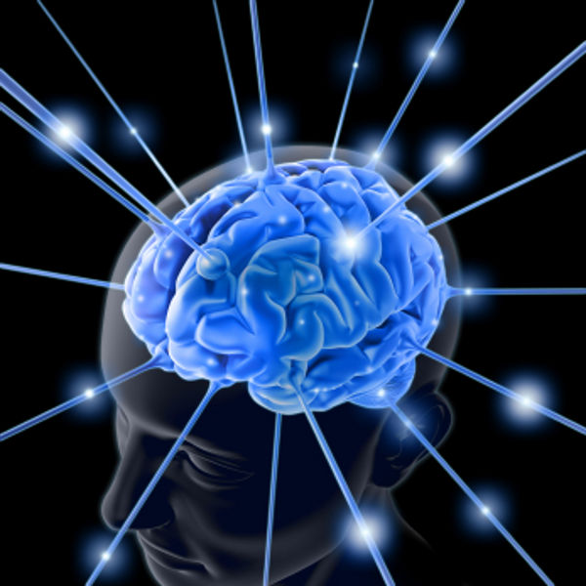
Why do we need proteins?
3. membrane channels (remember transport)
4. Neurotransmitters (carry nerve/brain messages)

Slide 7
Rna vs. dna

Slide 8
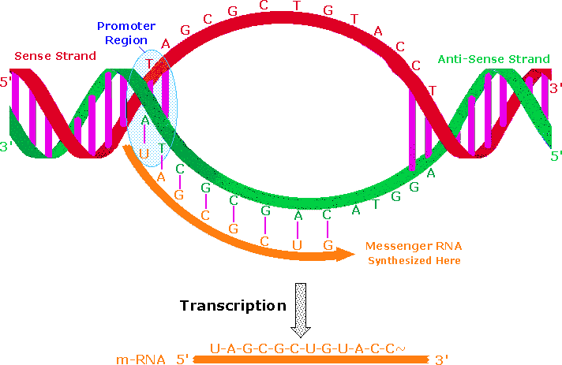
Dna in Protein Synthesis
Template for making mRNA during transcription
*Handout

Slide 9
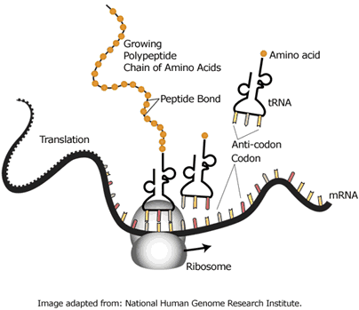
RnA
A. mRNA = messenger RNA
Makes and takes copy of DNA to cytoplasm
B. tRNA = transfer RNA
Matches w/ mRNA on ribosome
Carries amino acid (AA) to protein chain
C. rRNA = ribosomal RNA
Part of ribosome
Reads mRNA
Directs tRNA
*Handout

Slide 10
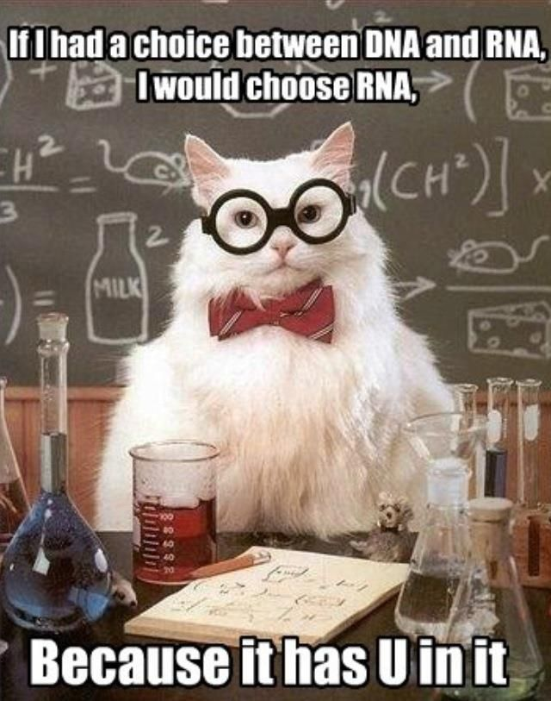

Slide 11
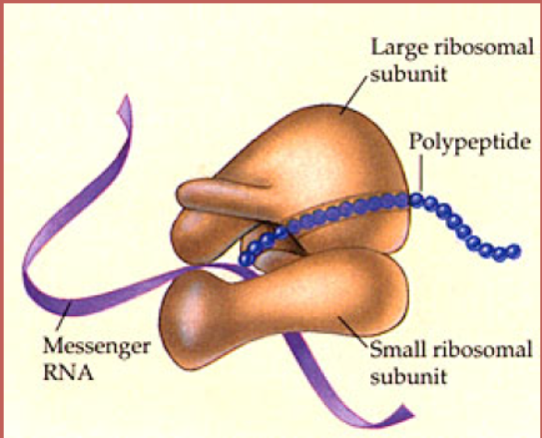
Ribosome
rRNA
Reads mRNA
Directs tRNA
Creates peptide bonds b/w AAs (makes polypeptide chain)

Slide 12
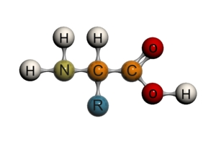
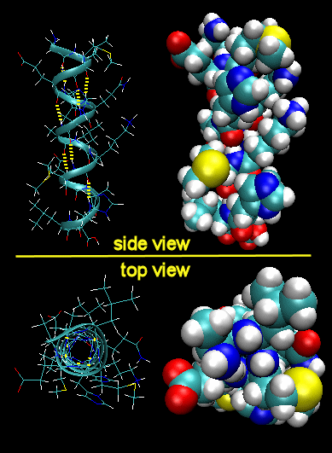
Amino Acids (AA)
Building blocks of proteins
(20 AA essential)
Protein = AA chain
A bunch of amino acids = polypeptide chain
ORDER MATTERS!
AA order determines f(x) of protein

Slide 13
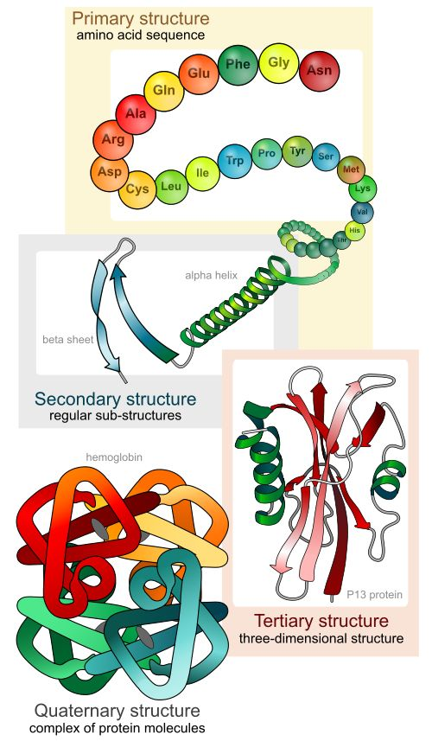

Slide 14
Vocab Handout

Slide 15
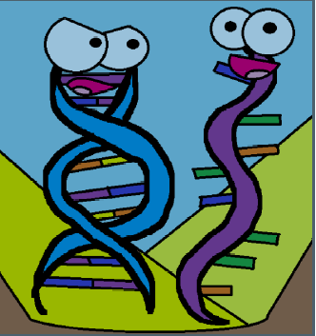
Amboea Sisters explain Protein Synthesis
Handout Notes

Slide 16
Steps of Protein Synthesis
1. Transcription (writing the “message”)
DNA → mRNA
Messenger carries code to cytoplasm
animation of transcription

Slide 17
mRNA leaves nucleus
2. Translation (reading the “message”)
mRNA → tRNA → protein (AA chain)
Message translated into a protein
translation animation

Slide 18
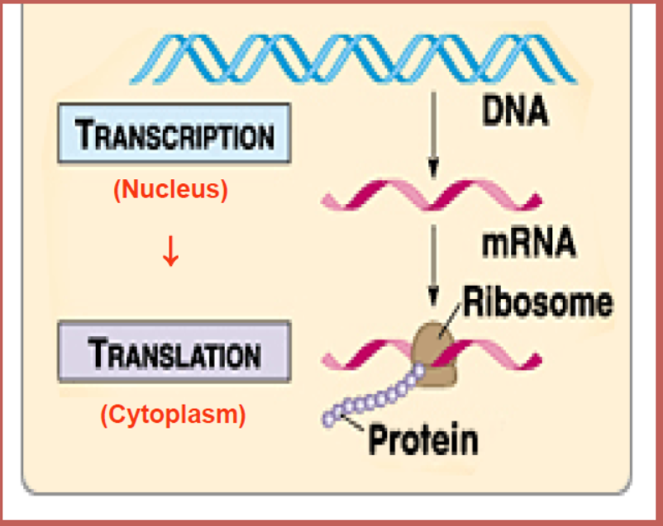

Slide 19
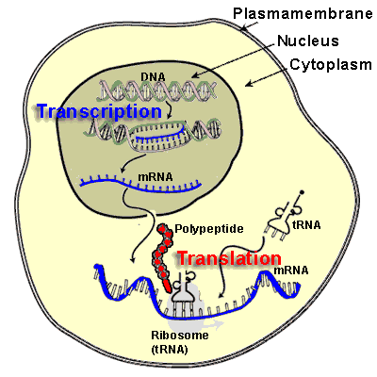
Transcription
DNA → mRNA
1. location: nucleus
2. Steps
A. enzyme binds to DNA, unzips it
B. mRNA copy of gene made from DNA template
* U replaces T in RNA

Slide 20
Transcription
3 DNA nucleotides (triplet)
mRNA codons
Handout

Slide 21
translation
mRNA → tRNA → protein (AA chain/polypeptide)
Location: cytoplasm
(first codon in mRNA is the start codon AUG)

Slide 22
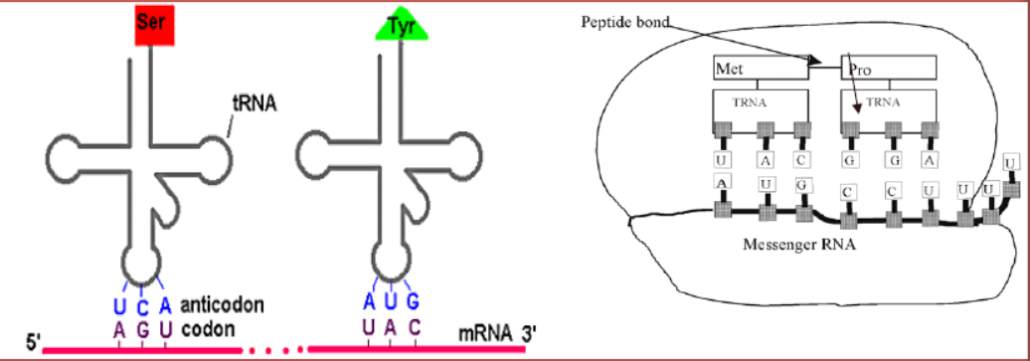
Steps of translation
1. mRNA moves to cytoplasm, binds to ribosome
2. tRNA anticodon UAC brings AA (methionine) to mRNA codon on ribosome
3. ribosome moves down mRNA to next codon
4. tRNA anticodon brings and attaches next AA with pepide bond

Slide 23
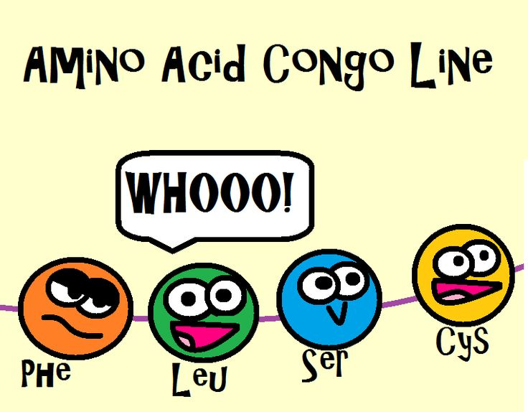
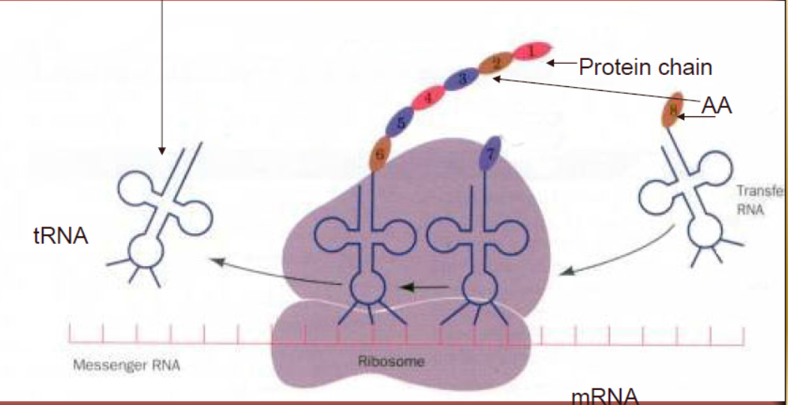
5. tRNA leaves ribosome once AA attached

Slide 24
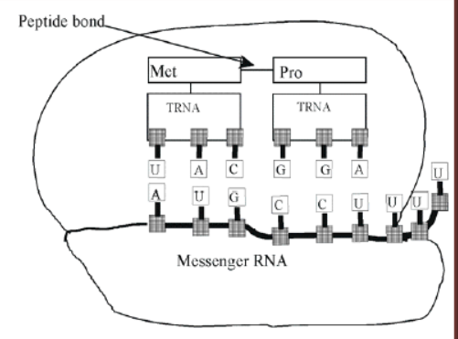
6. steps 1-5 repeated, adding AAs until stop codon* signals end of protein
7. polypeptide chain released from ribosome
translation animation
animation 2
animation 3
* UAG, UAA, UGA
Animation
Handout

Slide 25
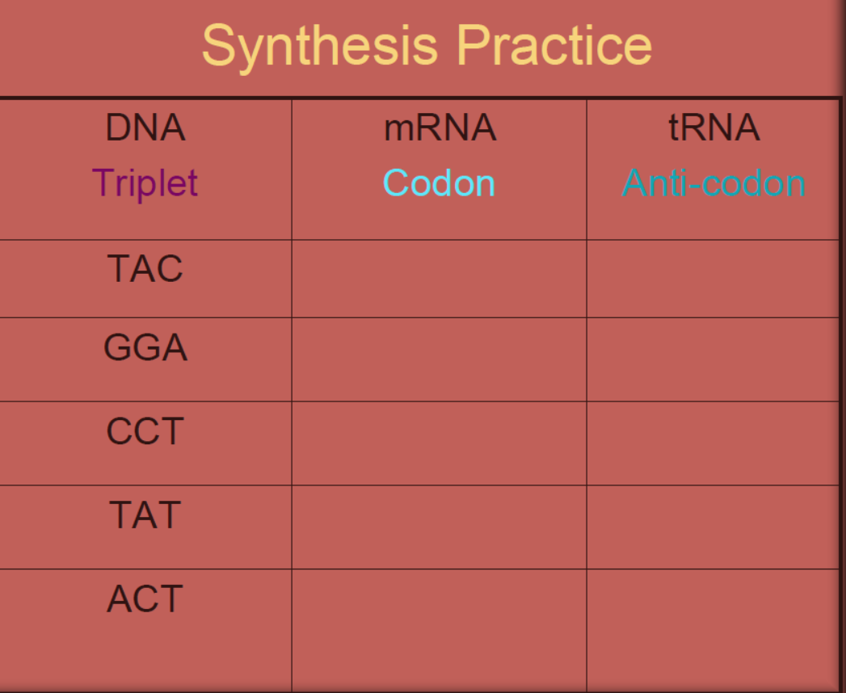
Let’s translation a try:
Codon chart/wheel
DNA song

Slide 26
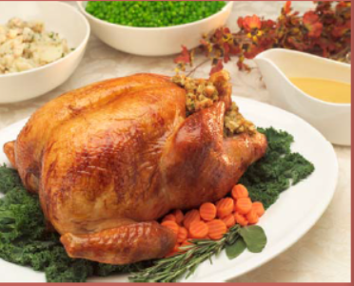
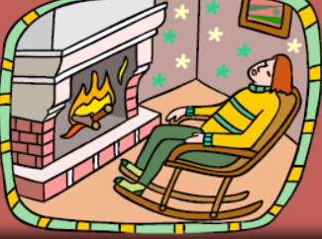
Amino Acid fun!
DNA triplet: ACC
mRNA codon: UGG
tRNA anti-codon: ACC
Amino Acid: tryptophan
Why should know this?
Tryptophan is in TURKEY-makes you sleepy

Slide 27
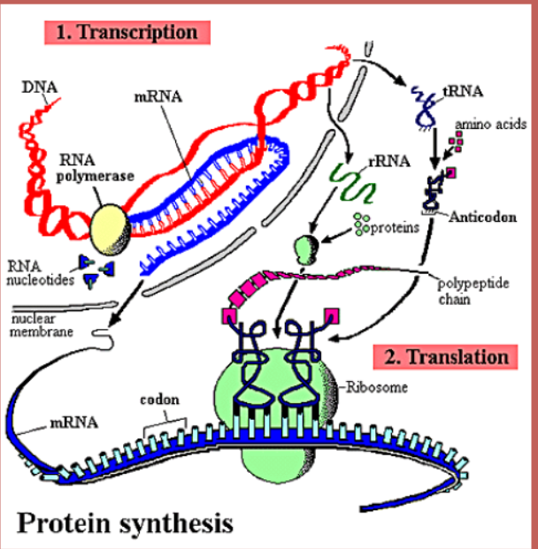

Slide 28
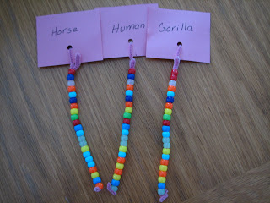
Transcribe and Translate your DNA name into a protein

