Slide 1
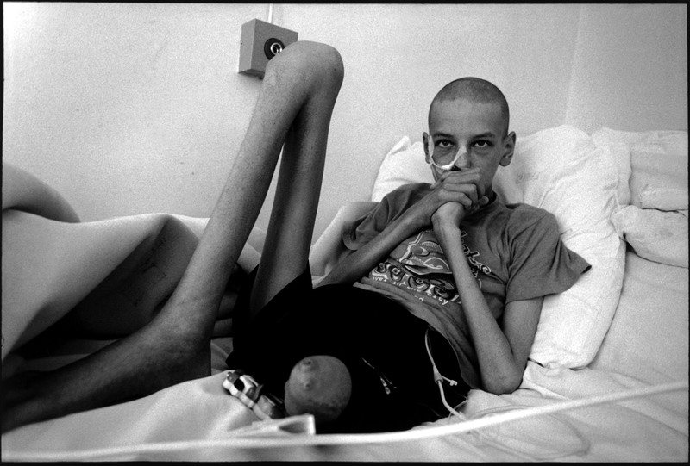
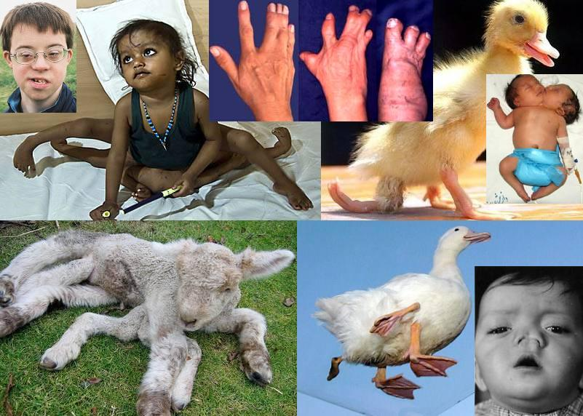
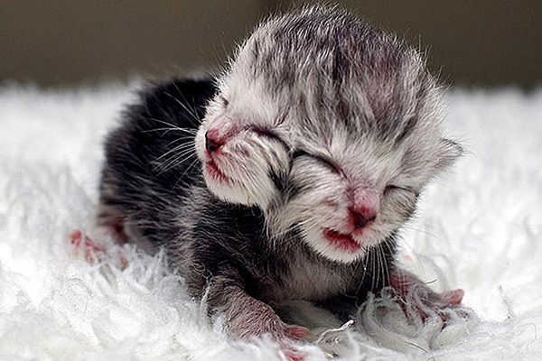
Types of Mutations

Slide 2
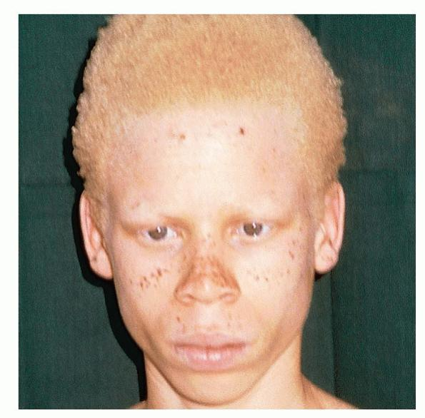
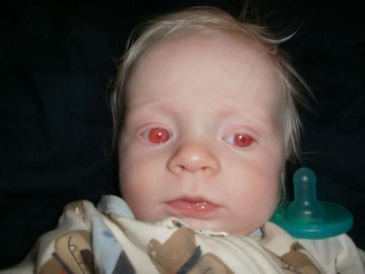
Albinism
Albinism occurs when one of several genetic defects makes the body unable to produce or distribute melanin, a natural substance that gives color to your hair, skin, and iris of the eye.

Slide 3
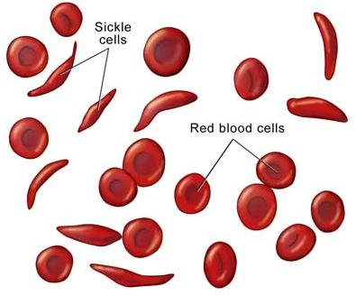
Sickle Cell Anemia
Sickle cell anemia is a disease passed down through families in which red blood cells form an abnormal sickle or crescent shape. Red blood cells carry oxygen to the body and are normally shaped like a disc.

Slide 4
PKU (Phenyiketonuria)
is an inherited disorder that increases the levels of a substance called phenylalanine in the blood. Phenylalanine is a building block of proteins (an amino acid) that is obtained through the diet. It is found in all proteins and in some artificial sweeteners.
resulting from a genetic mutation, in which the body lacks the enzyme to metabolize phenylalanine. If untreated, it results in developmental deficiency, seizures, and tumors.

Slide 5
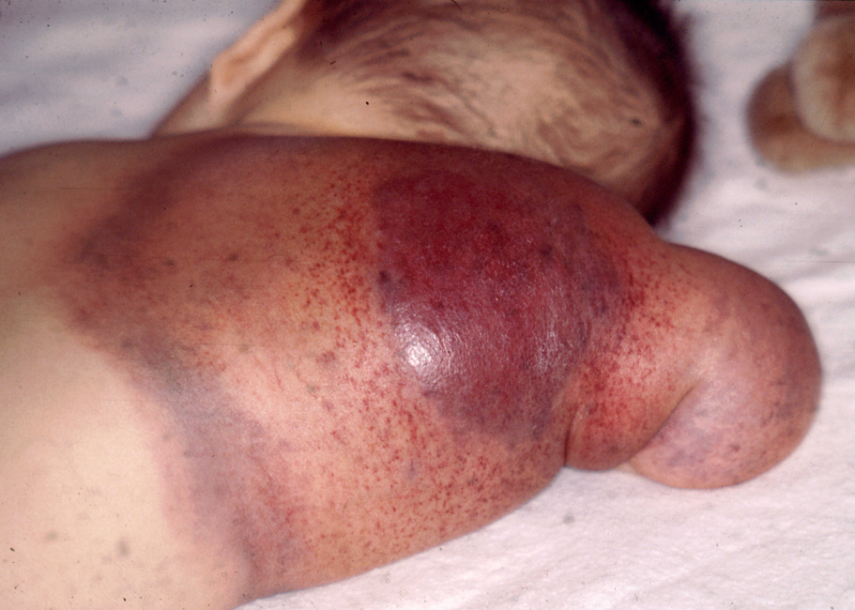
Hemophilia
Hemophilia refers to a group of bleeding disorders in which it takes a long time for the blood to clot.
Ex. Bleeding into joints

Slide 6
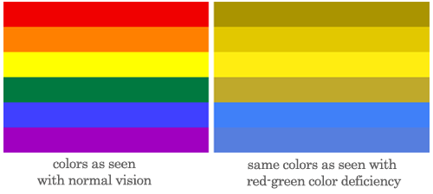
Color Blindness
Most color vision problems are inherited (genetic) and are present at birth.
Inherited color blindness happens when you don't have one of these types of cone cells or they don't work right. You may not see one of these three basic colors, or you may see a different shade of that color or a different color. This type of color vision problem doesn't change over time.
A color vision problem isn't always inherited. In some cases, a person can have an acquired color vision problem. This can be caused by:
Aging.
Eye problems, such as glaucoma, macular degeneration, cataracts, or diabetic retinopathy.
Injury to the eye.
Side effects of some medicines.
Color blindness means that you have trouble seeing red, green, or blue or a mix of these colors. It’s rare that a person sees no color at all.

Slide 7
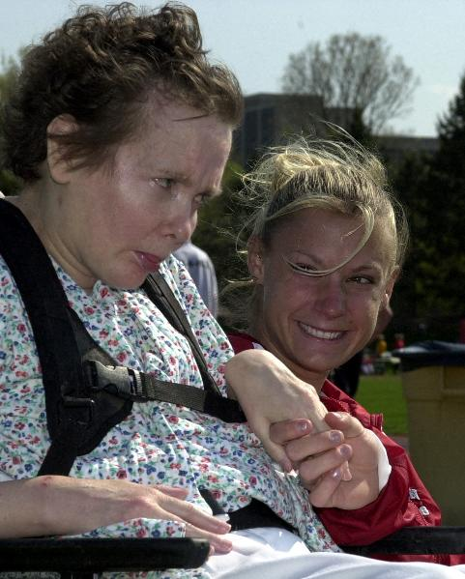
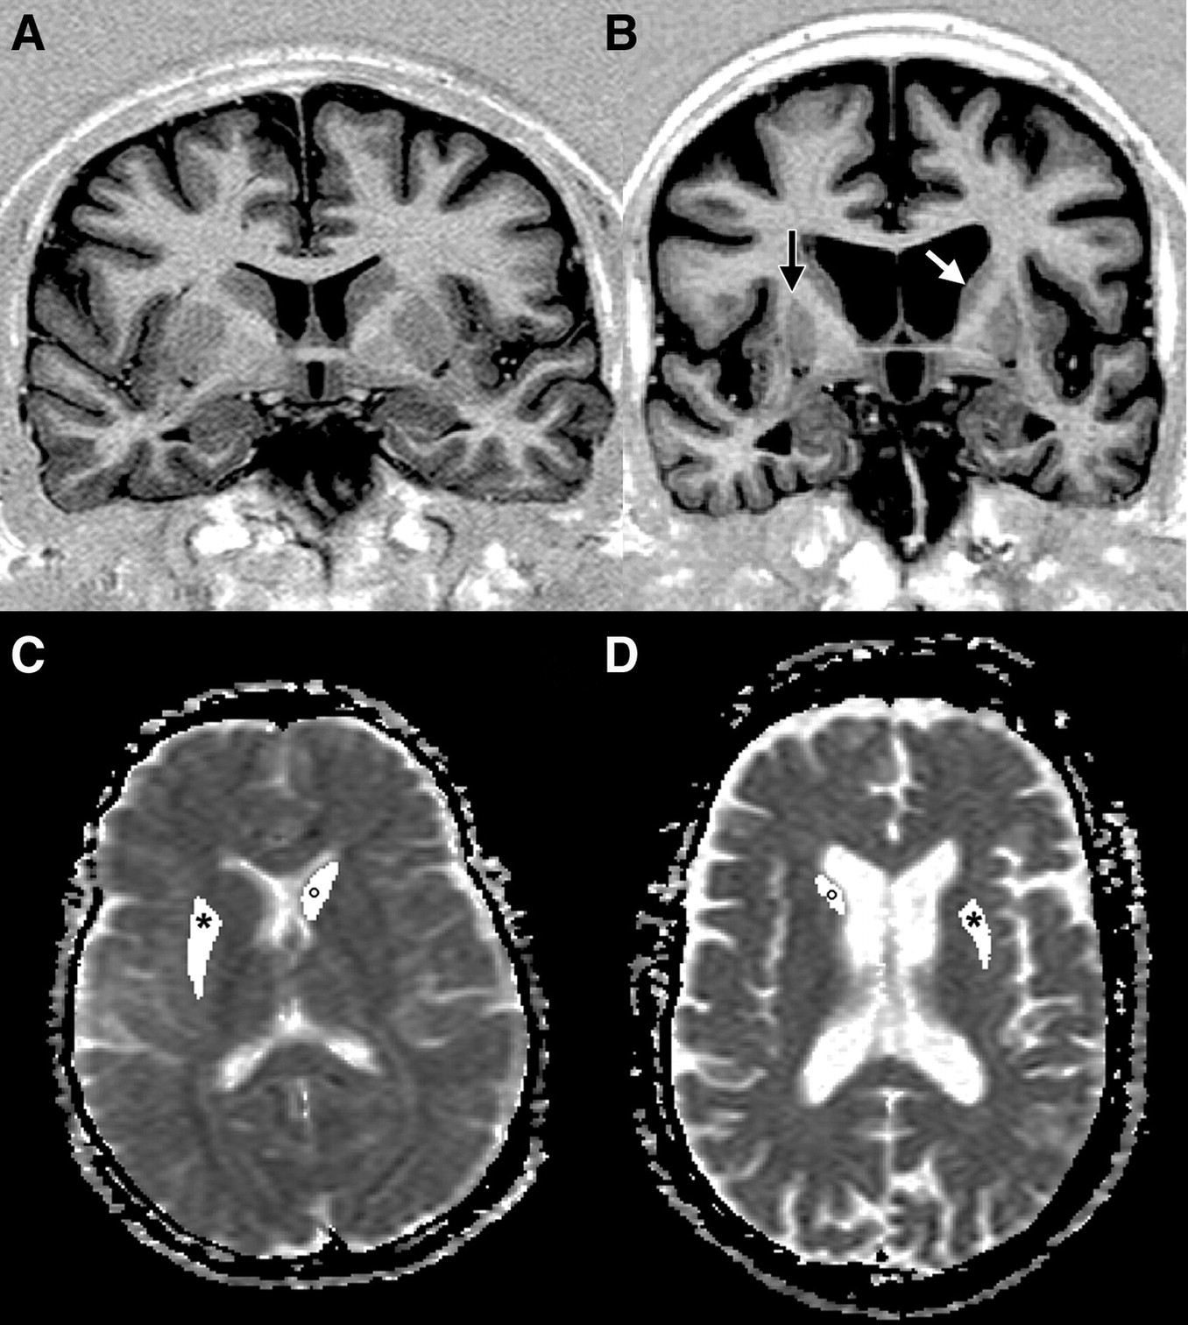
Huntington Disease
Huntington's disease is an inherited disease that causes the progressive breakdown (degeneration) of nerve cells in the brain. Huntington's disease has a broad impact on a person's functional abilities and usually results in movement, thinking (cognitive) and psychiatric disorders.

Slide 8
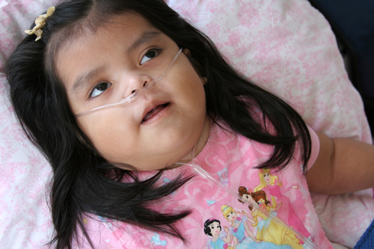
Tay-Sachs
disease is a deadly disease of the nervous system passed down through families.
Deafness
Decreased eye contact, blindness
Decreased muscle tone (loss of muscle strength)
Delayed mental and social skills
Dementia
Increased startle reaction
Irritability
Listlessness
Loss of motor skills
Paralysis or loss of muscle function
Seizures
Slow growth

Slide 9
Cystic fibrosis
Cystic fibrosis is a disease passed down through families that causes thick, sticky mucus to build up in the lungs, digestive tract, and other areas of the body. It is one of the most common chronic lung diseases in children and young adults. It is a life-threatening disorder.

