Slide 1
Basic Shelving in the Library

Slide 2
Easy Shelves
Books are shelved according to the first letter of the author’s last name
Most shelves only have one letter
The E stands for Easy. This tells me the book belongs in the Easy section.
The W is the first letter of the author’s last name. This tells me the book belongs on the W shelf.

Slide 3
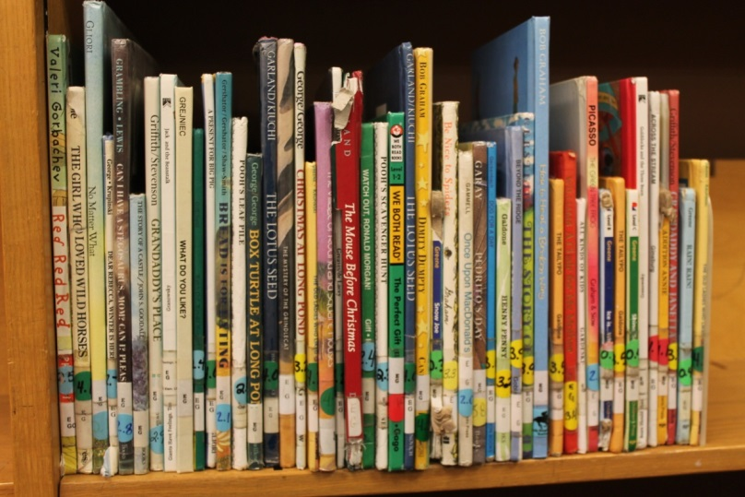
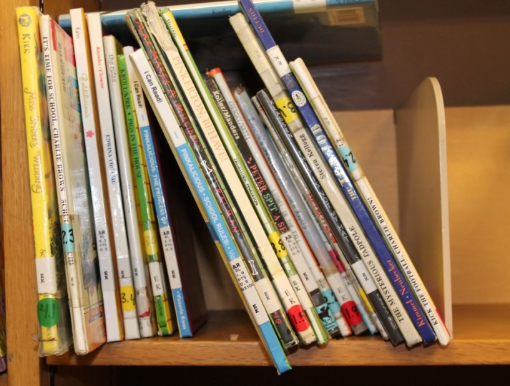
Let’s look at the shelves…
Messy shelf! Books upside down and thrown on top of the other books.
Neat shelf! All books pulled to front, all on the correct shelf!

Slide 4
Chapter Book Shelving
Books are shelved according to the first letter of the author’s last name (except some series)
Some stickers have the first 3 letters of the author’s last name, but we shelve only according to the first letter at this time
Book series have a pink dot and are shelved separately
The letters FIC tell us these are chapter books.
Even though these might seem different, they can be shelved side by side in this library. Ignore all letters except for the first one.

Slide 5
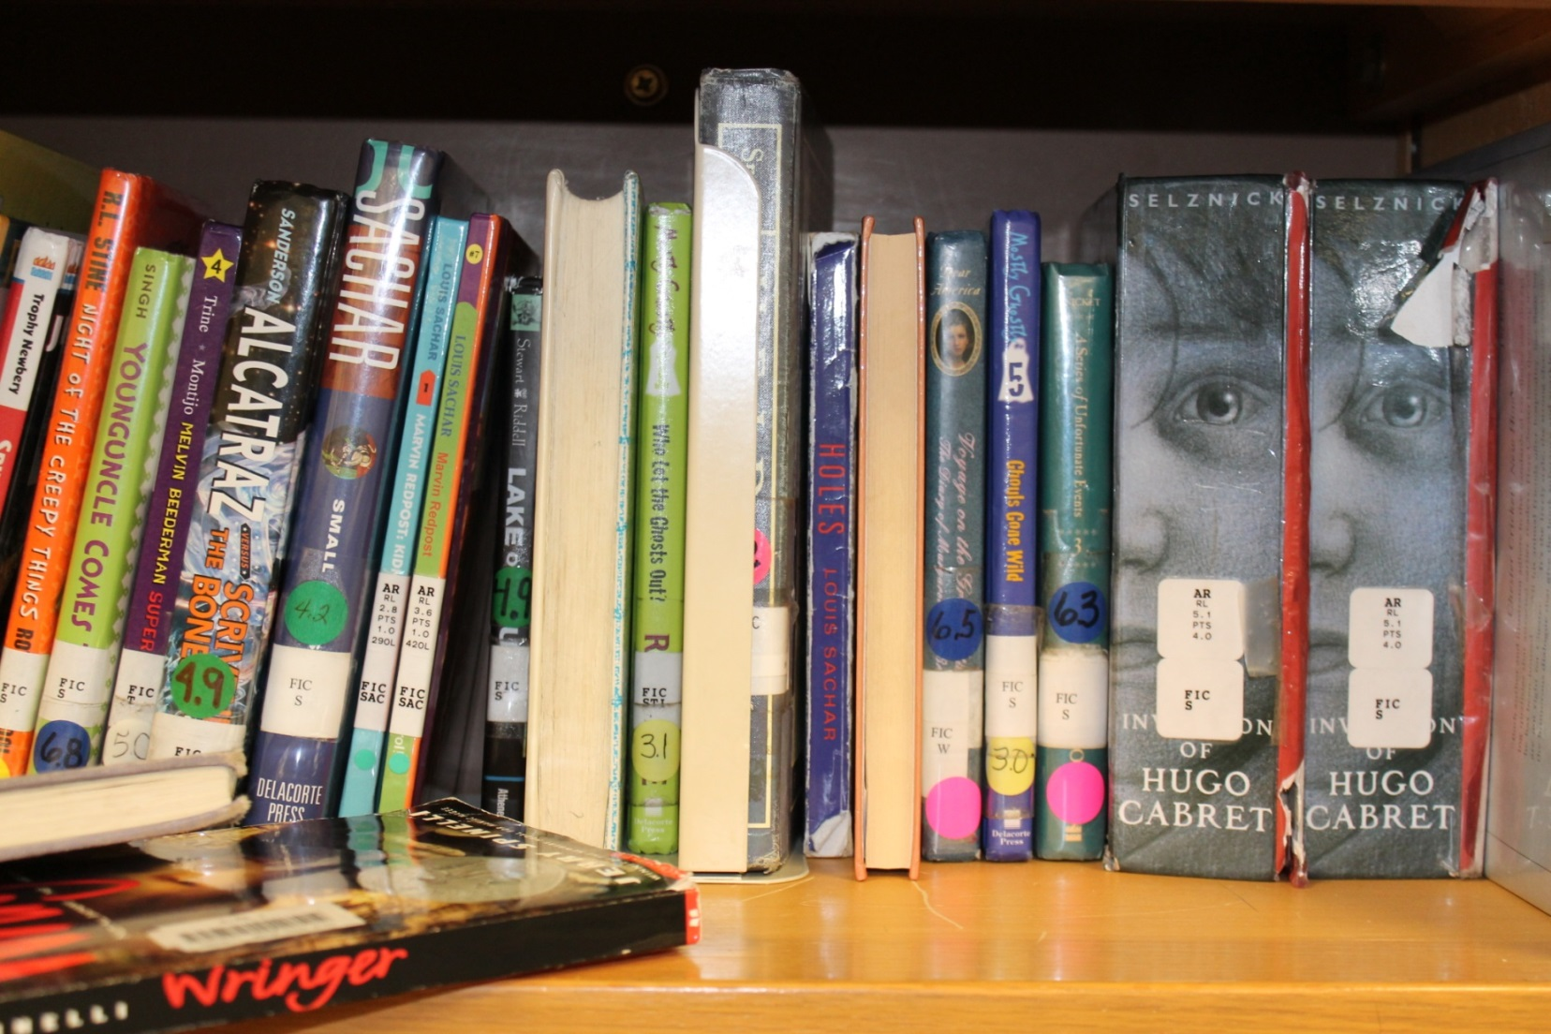
What’s wrong with this shelf?

Slide 6
Nonfiction Book Shelving
The hardest job – but you can do it!
Books are shelved according to the call number, in number order.
Stickers will also have the first 3 letters of the author’s last name, but we shelve only according to the number
The book’s Dewey Decimal number. This tells us which shelf it belongs on.
The last 3 letters of the author’s last name. We ignore these when shelving in our library.

Slide 7
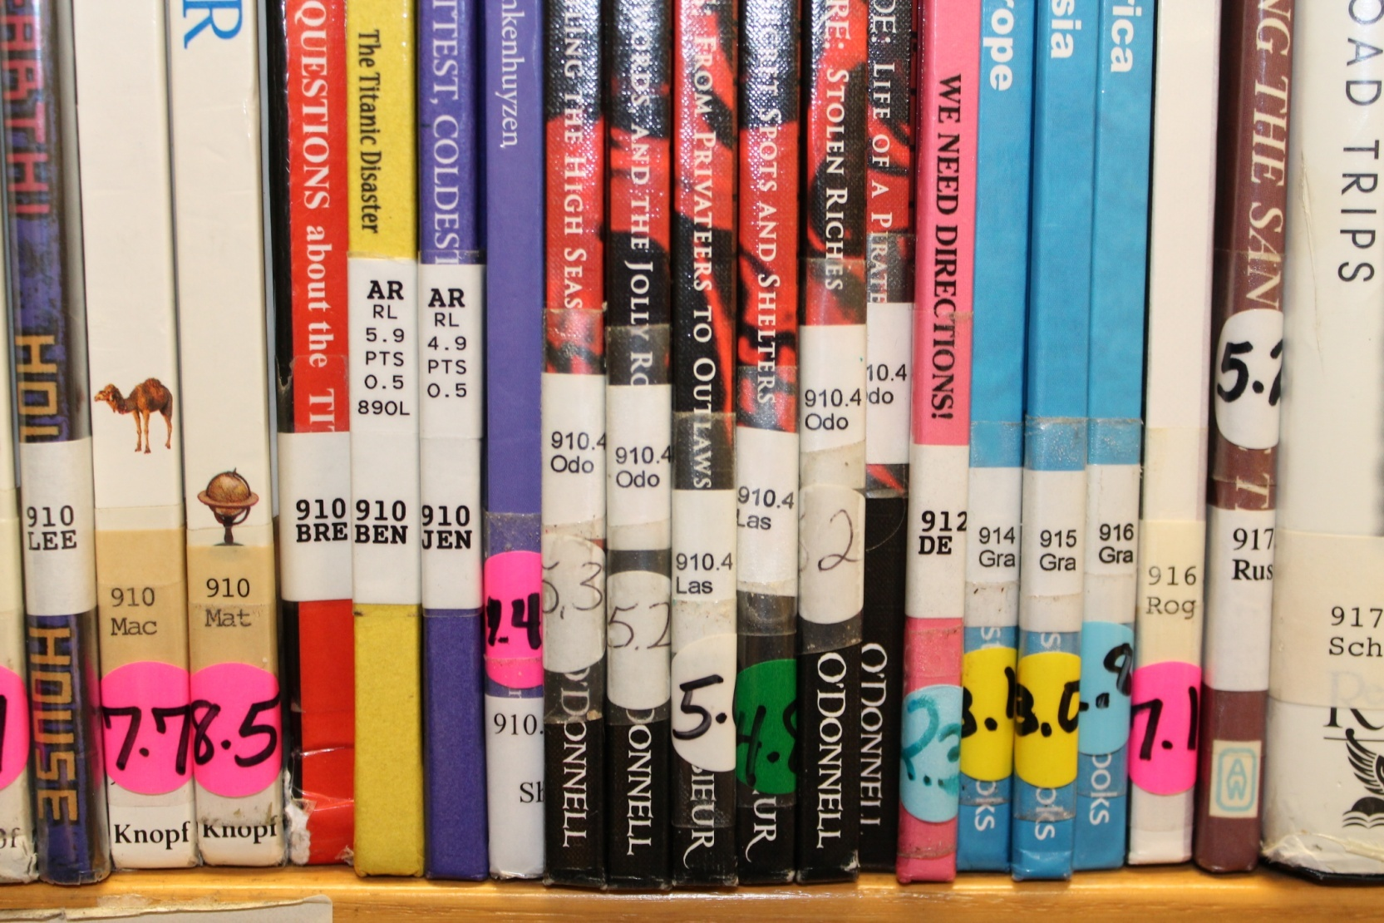
Is anything wrong with this shelf?

