Slide 1
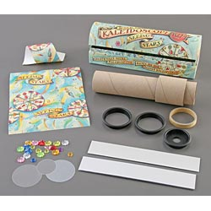
Kaleidoscope: Multiple Reflections
Students make and experiment with a kaleidoscope while answering guided discussion questions.
Grades: 4-12

