Slide 1
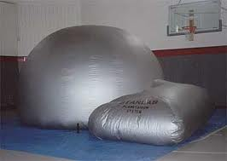
STARLAB: Portable Planetarium
STARLAB is a portable planetarium. It is an inflatable dome capable of accommodating up to 35 students and 25 adults. Inside the dome, a cylinder projector is not only able to show us the night sky devoid of any light pollution; it can take us on a journey to observe our whole galaxy and study the solar system. STARLAB can serve as a great vehicle for exploring other cultures. We can see the sky through the eyes of ancient Greeks and study the mythology of Native Americans.
Grades K-12

