Slide 1
Radish

Slide 2
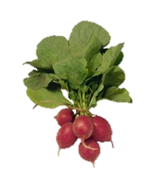
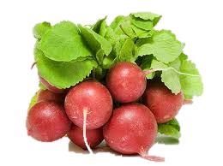
What is a Radish?
An edible root vegetable.
A root vegetable is the edible root
of certain vegetables.

Slide 3
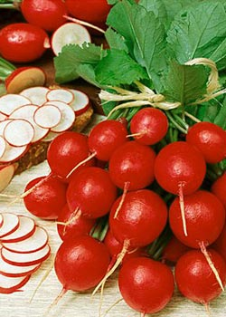
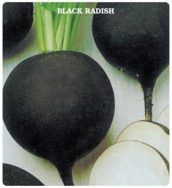
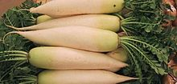
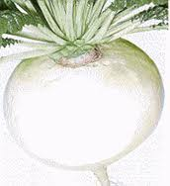
There are five varieties of radishes:
Red Globe
Black
Daikons
White Icicles
California Mammoth White
Red Globe

Slide 4
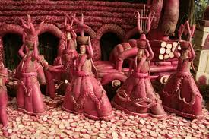
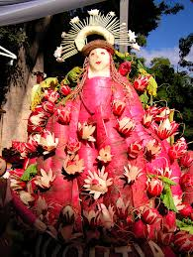
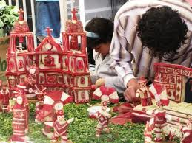
Night of the Radishes
Celebrated every year on December 23 in Spain
The people carve vegetables into historical and biblical scenes.

Slide 5
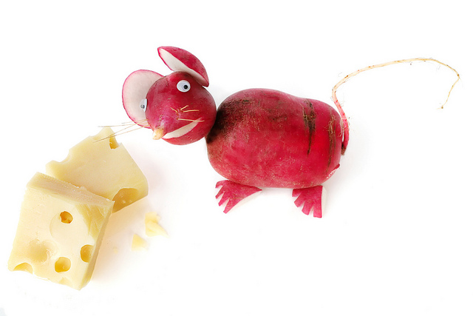
CCCTS
Business Marketing

