Slide 1
Gifted Referral Process and Other Important Information
Coffee County Schools
2016-2017

Slide 2
What Does “Gifted” Mean?
Intellectually gifted children and youth are those who perform or who have demonstrated the potential to perform at high levels in academic or creative fields when compared with others of their age, experience, or environment.
(Source: Alabama State Department of Education. 2009)
Notes:
Nurture and foster their potential

Slide 3
Who can refer a student?
A student may be referred for consideration for gifted services by teachers, counselors, administrators, parents or guardians and other individuals with knowledge of the student’s abilities.

Slide 4
Notification and Consent
If a student is referred for consideration for the gifted program, his/her parents must give consent for screening.
If a student is found eligible, parents must also give consent for placement and a GEP (gifted education plan).

Slide 5
Teacher Input
Required teacher input for any gifted referral includes:
Part of the Referral Form
TAB’s Form
Work Samples

Slide 6
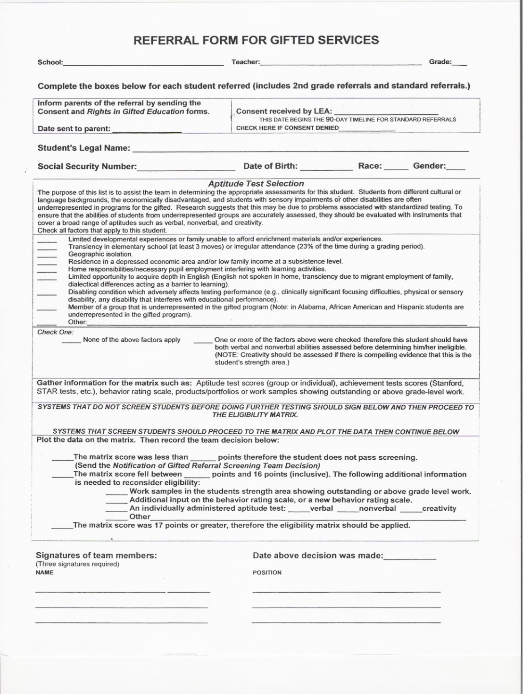
Referral Form
Check anything that applies in the “Aptitude Test Selection Box.”
The “Gifted Referrals Screening Team” (GRST) will use this information to determine if the student needs both verbal and nonverbal assessments.
GRST members are:
General Ed. Teacher,
Gifted Ed. Teacher,
LEA

Slide 7
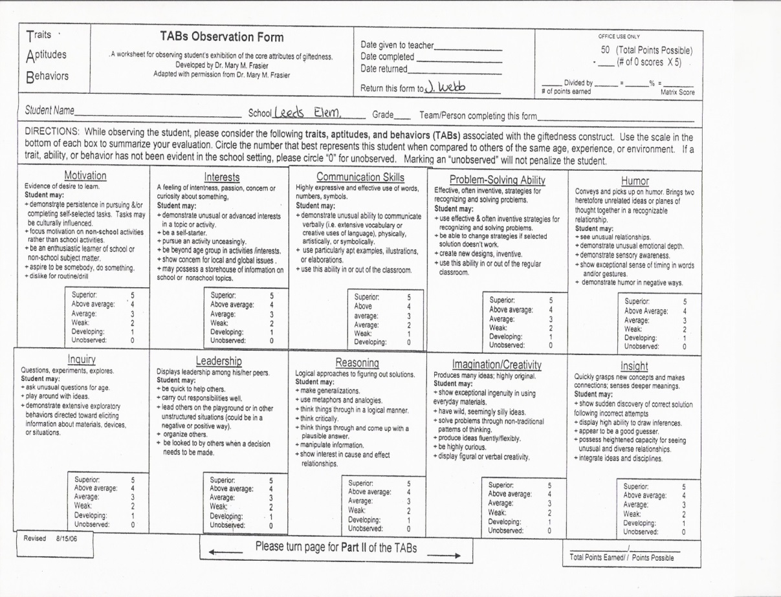
TAB’s Form
The TAB’s, or traits, aptitudes and behaviors are a representation of the basic characteristics associated with giftedness.
The teacher must give the referred student a rating in each area of the TAB’s.
Rating Scale:
5 Superior
4 Above Average
3 Average
2 Weak
1 Developing

Slide 8
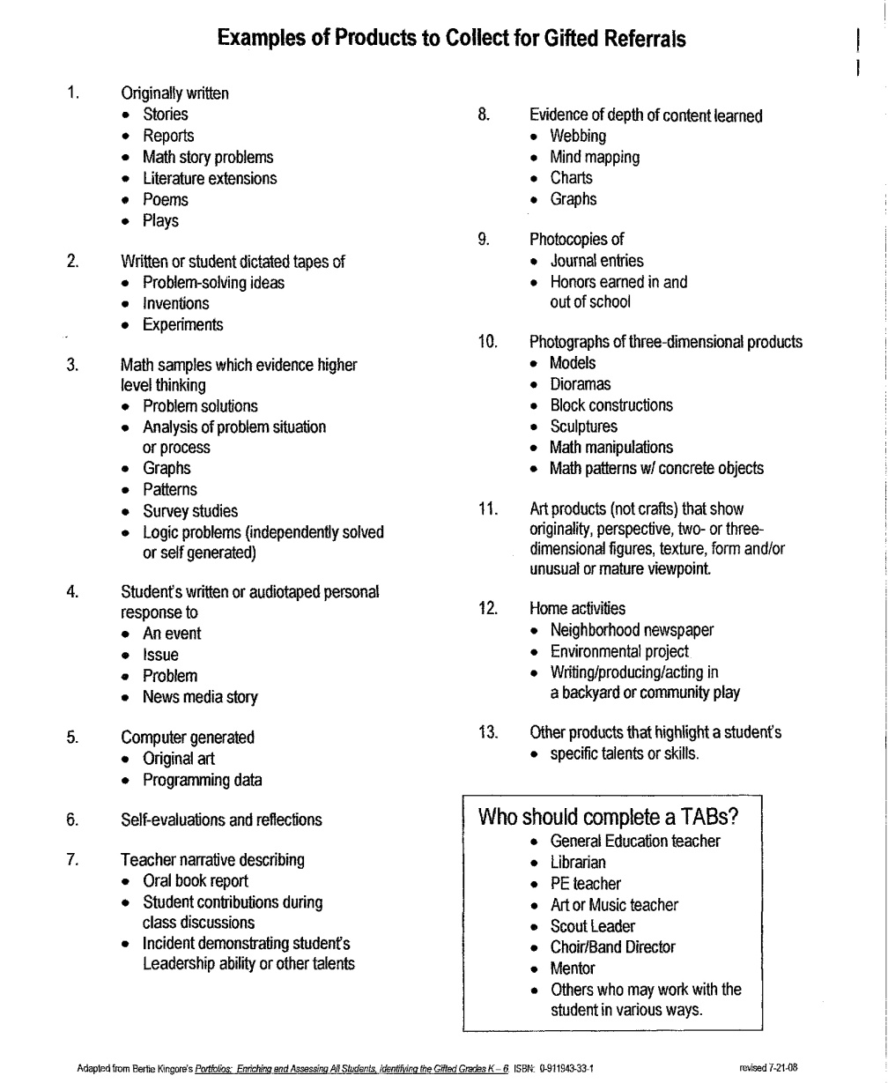
Work Samples
The teacher will need to provide 3 or more (above average) work samples for your referred student.
The samples should demonstrate different abilities.

Slide 9
Testing
The student will have his/her hearing and vision tested.
The student will receive a screener test from the gifted teacher (OLSAT scores can be used as a screener test).
Some students may be tested by the school psychometrist.

Slide 10
Gifted Service Delivery Options in Coffee County Schools
Grades K-2 – regular classroom accommodations with consultations from the gifted teacher as needed.
Grades 3-6– resource room pull-out.
Grades 6-8 – differentiation in the general education classroom.
Grades 9-12 – advanced classes in core content areas.

Slide 11
Why Should Gifted Students Attend Gifted Classes?
Curriculum in gifted classes includes reading, writing and thinking at high levels.
Students are often reading and writing in their interest areas to complete a project of choice – this motivates students to read, write and research.
Gifted classes meet social-emotional needs of gifted learners.
Attending gifted classes can maintain a desire for the student to come to and remain in school.
From: Alabama State Department of Education – Gifted Regional Training 2010

Slide 12
Other Important Info
According to the Alabama State Department Gifted Code accommodations must be provided for the times that gifted students are in pull-out classes:
  Students will not be required to make up missed class work.
  If new material is introduced, students will be instructed by peer or teacher in small group or one-on-one setting.
  If tests are administered, students will take the test when he or she returns to the classroom or at a mutually agreed upon time.

