Slide 1
GRADEQUICK/EDLINE
Presented By:
Dawn Gessel
Putnam County Schools

Slide 2
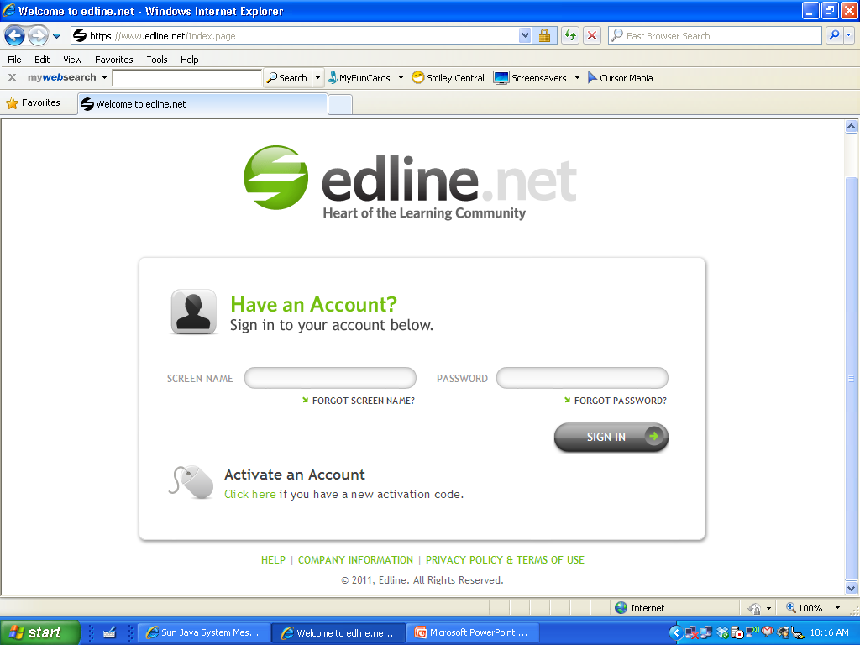
LOGGING INTO EDLINE

Slide 3
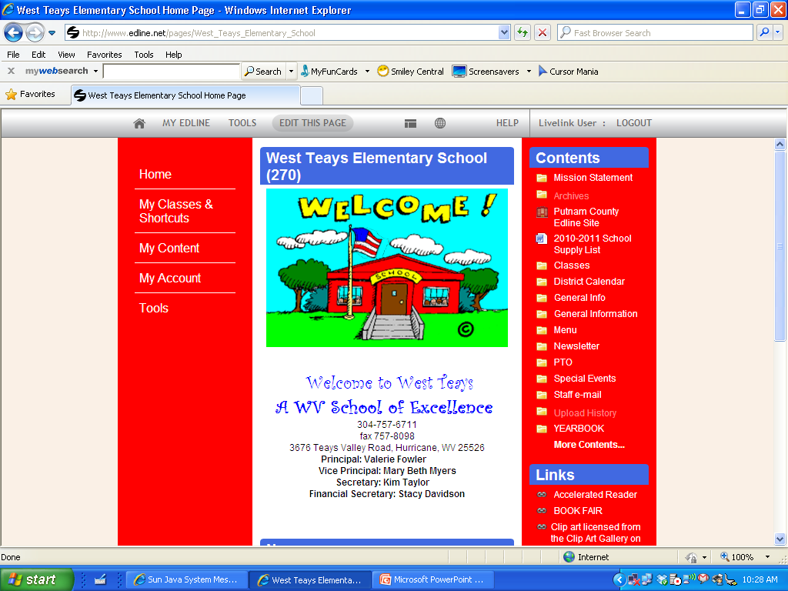

Slide 4
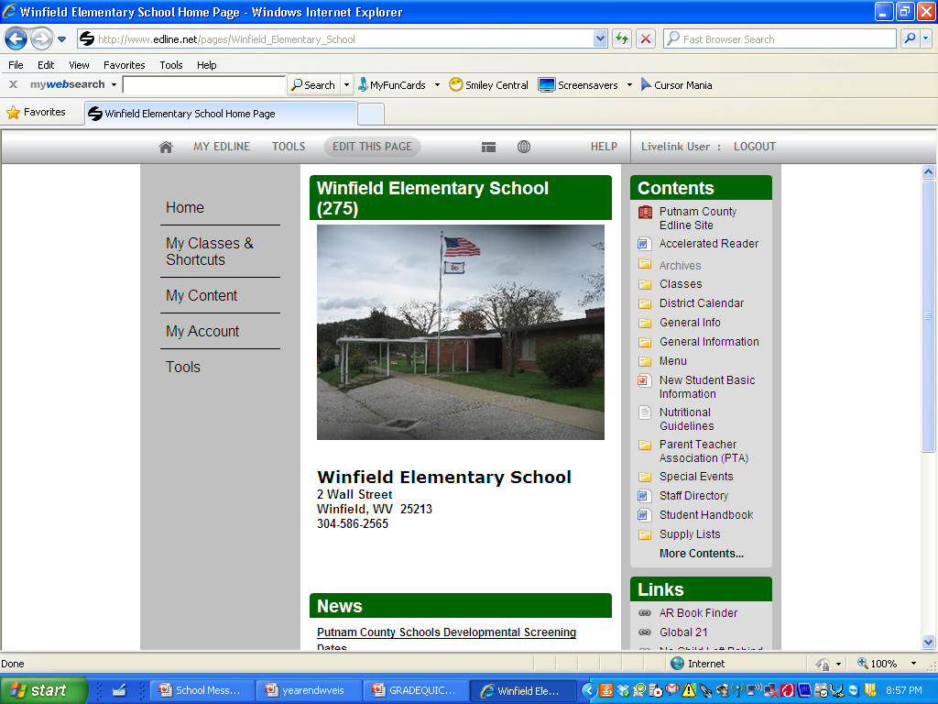
The Old Look for Winfield Elementary

Slide 5
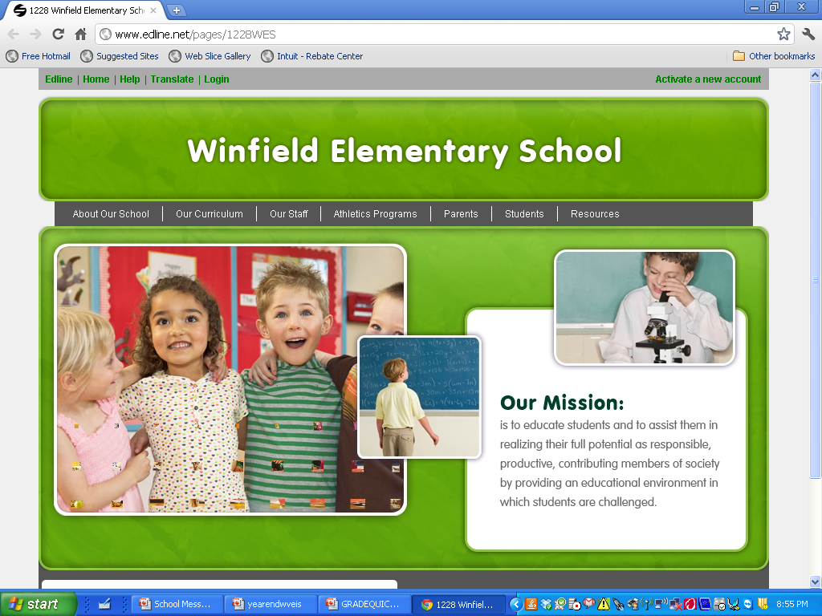
The NEW LOOK

Slide 6
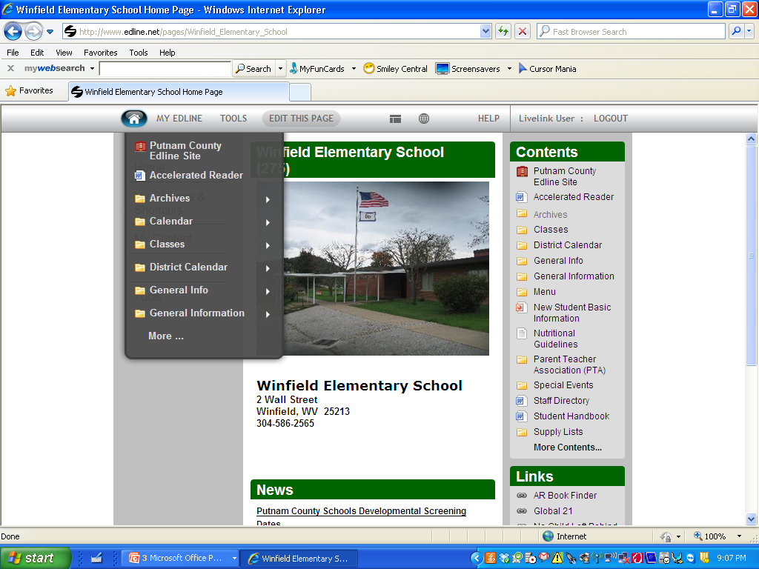
Home Menu

Slide 7
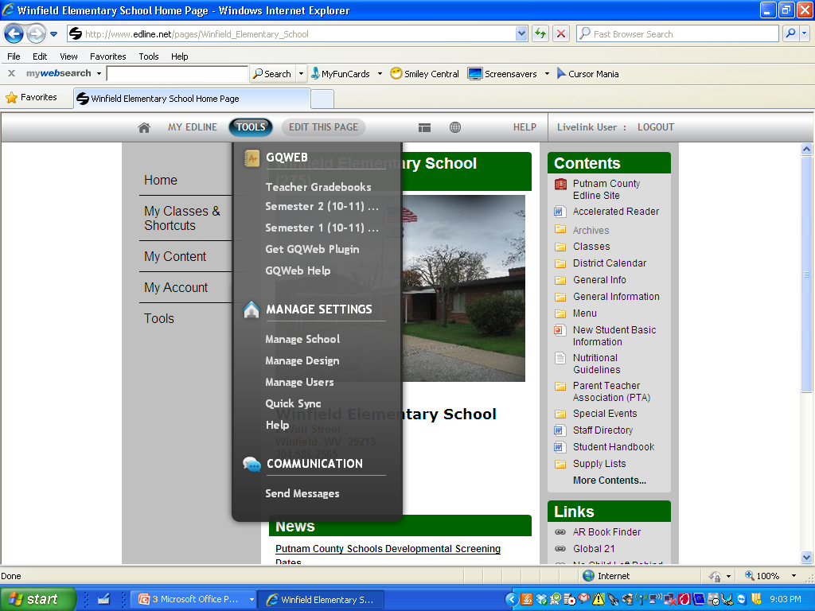
Tools Menu

Slide 8
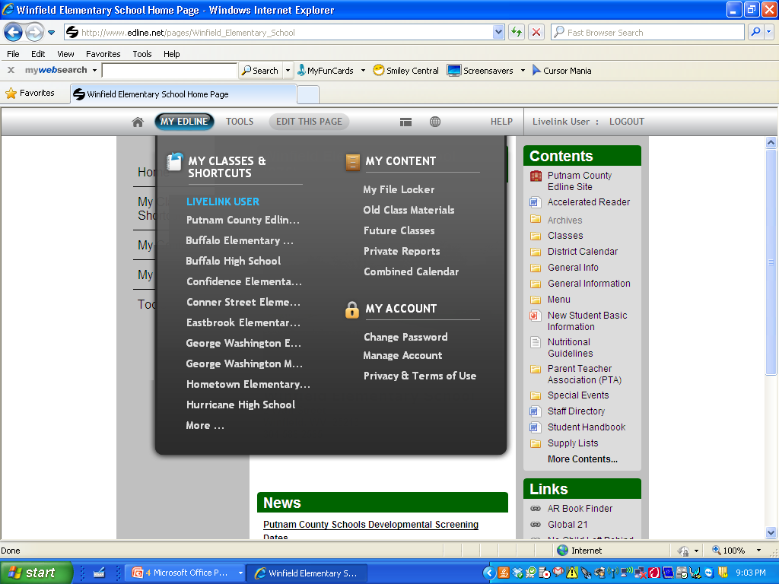
My Edline Menu

Slide 9
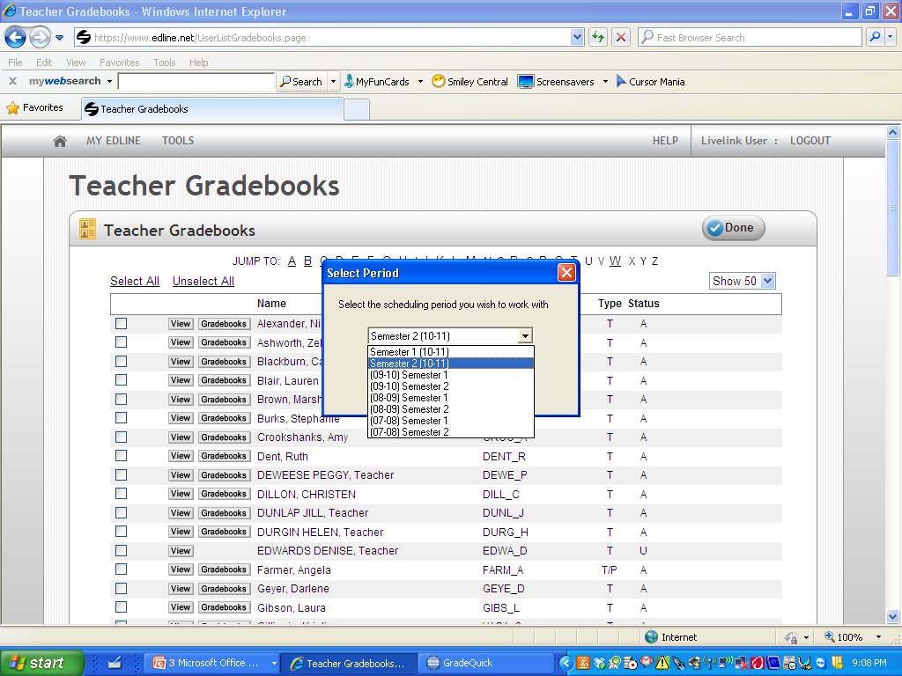
Teacher Gradebooks/Select Grading Period

Slide 10
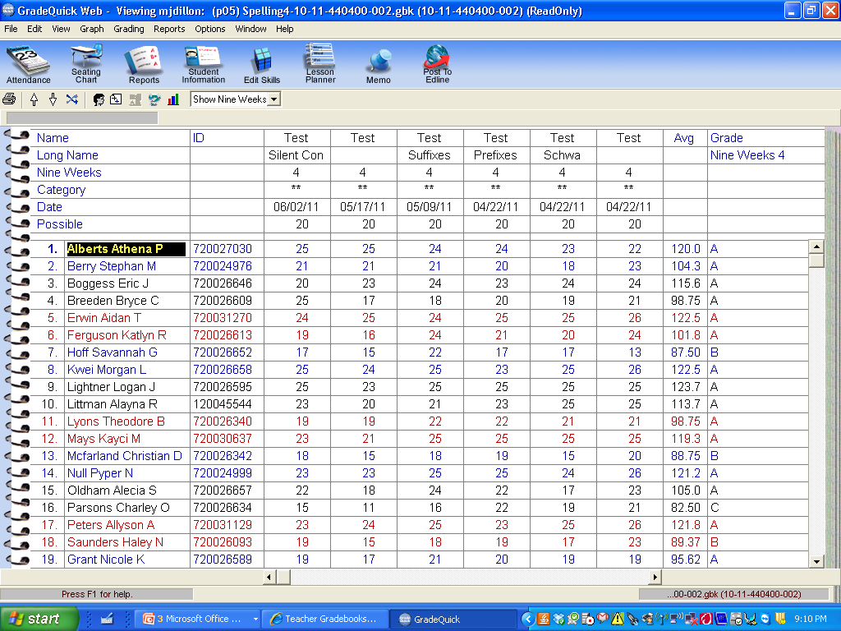
Teacher Gradebook

Slide 11
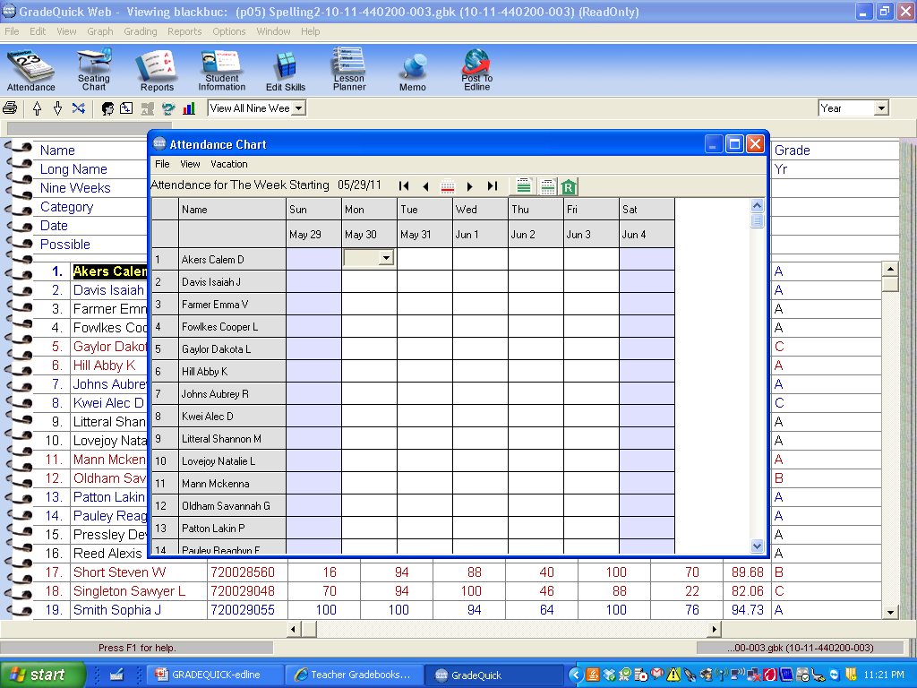
Taking Attendance

Slide 12
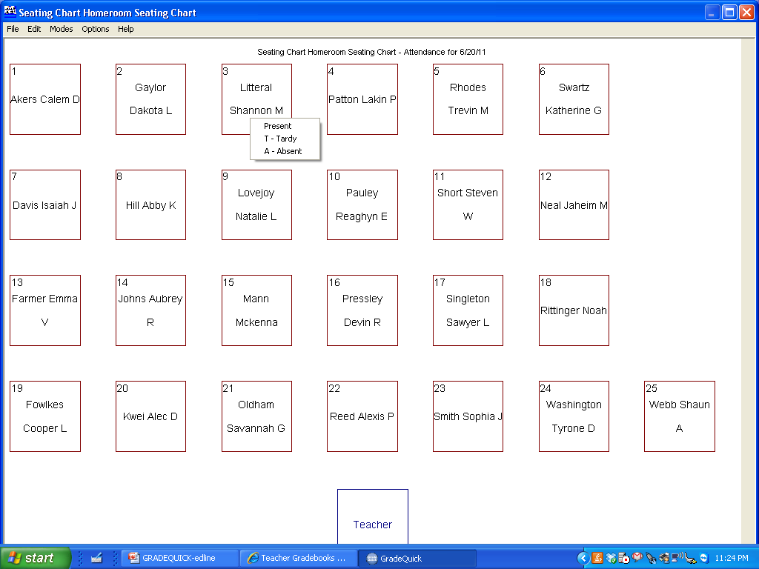
Taking Attendance via Seating Chart

Slide 13
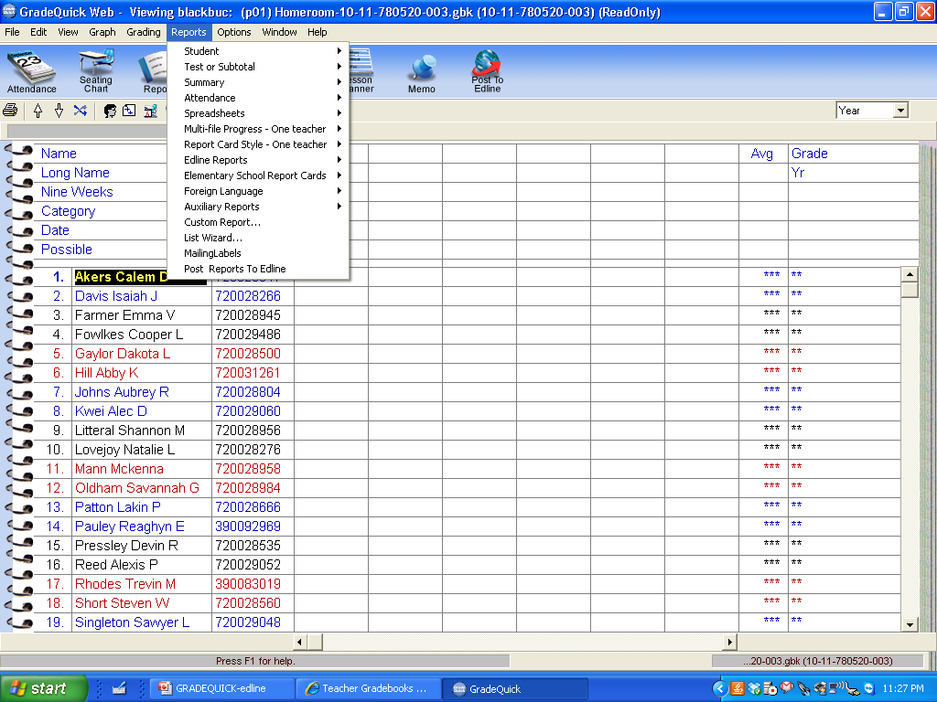
Reports

Slide 14
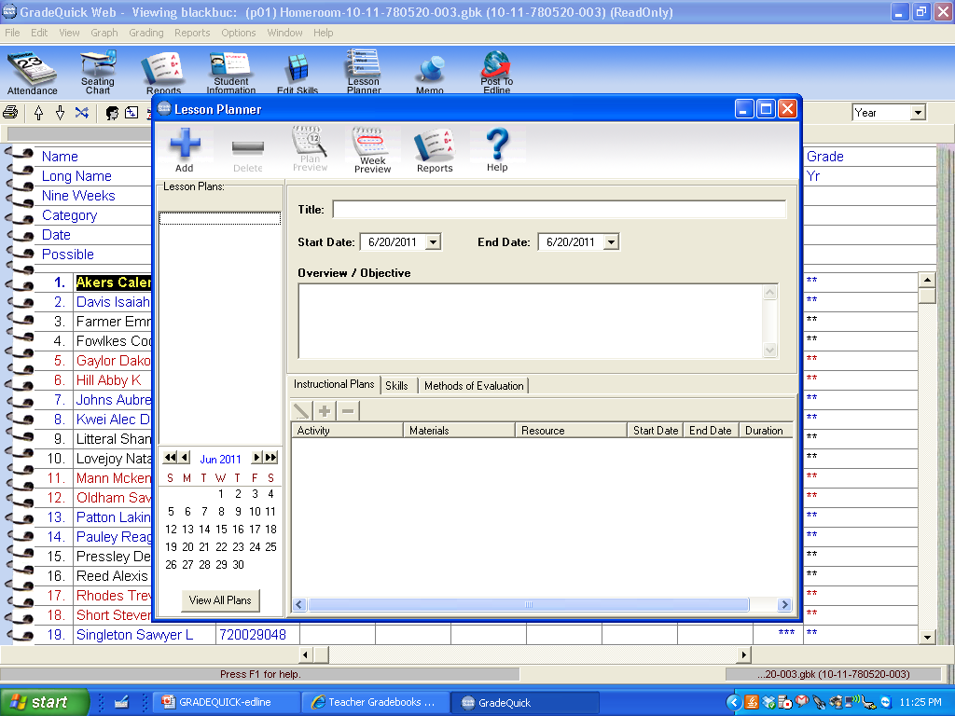
Lesson Planner

Slide 15
Additional Edline Features
Edline Parent Notification (Tel A Parent)
Interactive Classrooms Ex. Homework Hand-In, Online Quizzes, and Interactive Assignment
Surveys
Student Dropbox (10mb)
Web Lockers
Blog
Automated Update of Rosters

